Slide 1
Major Causes of Maintenance Problems: Refactoring & Code Clones Analysed
D. A. Tamburri, Ph.D.

Slide 2
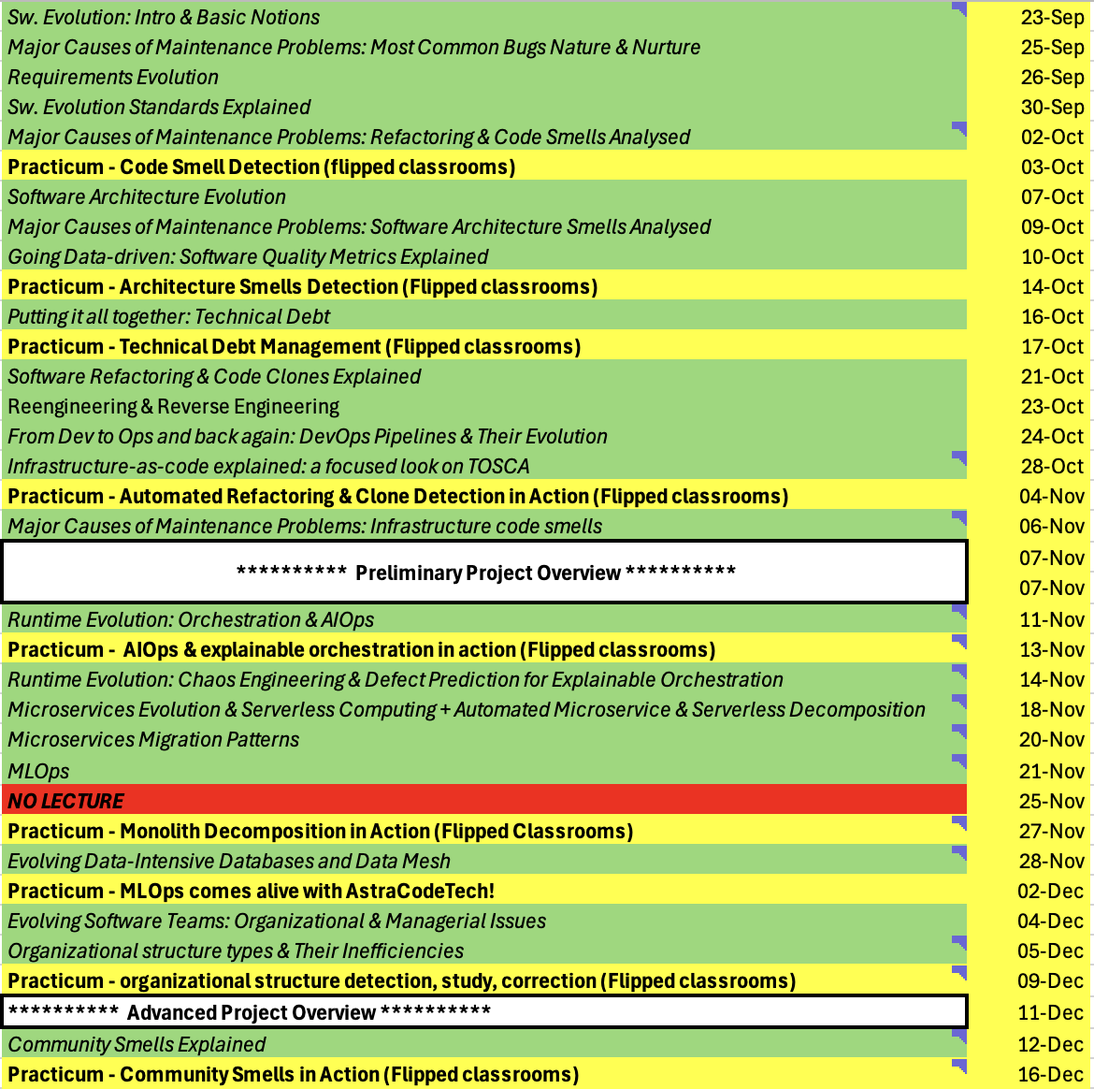

Slide 3
APR!
Notes:
17, tDebt → antonaccio et al.

Slide 4
Oh and one more thing…
Each team report in 15 mins (10 mins pres. + 5 mins Q&A):
Chose project and tentative approach;
Challenges so far;
Eventual Research/Maintenance/Evolution/Quality Goal;
Timeline;

Slide 5
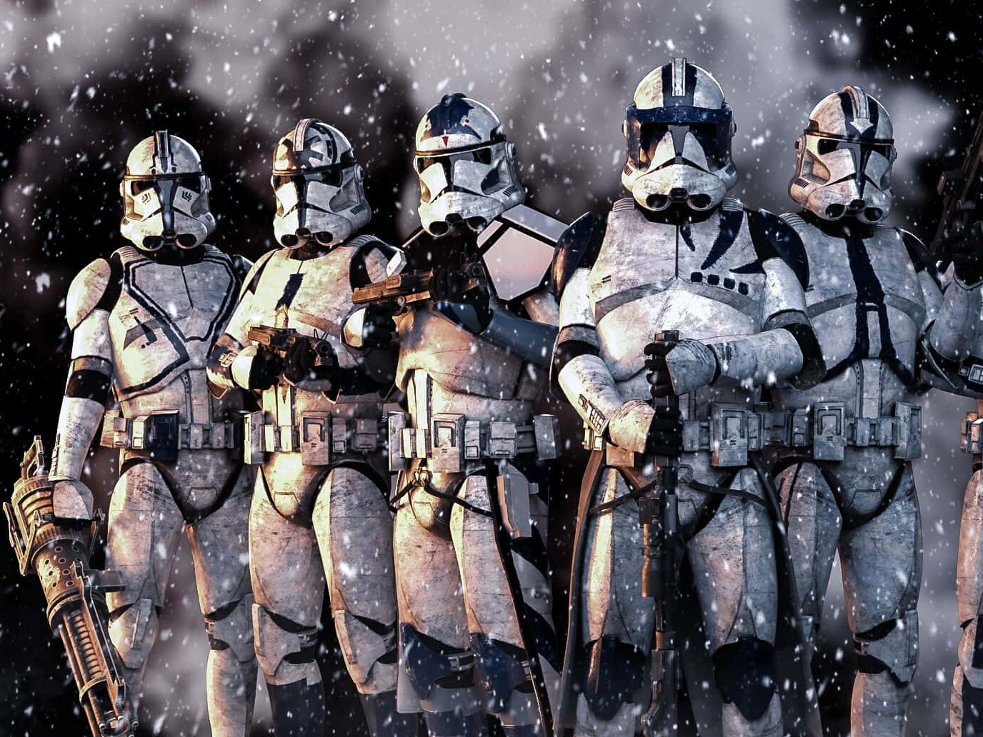

Slide 6
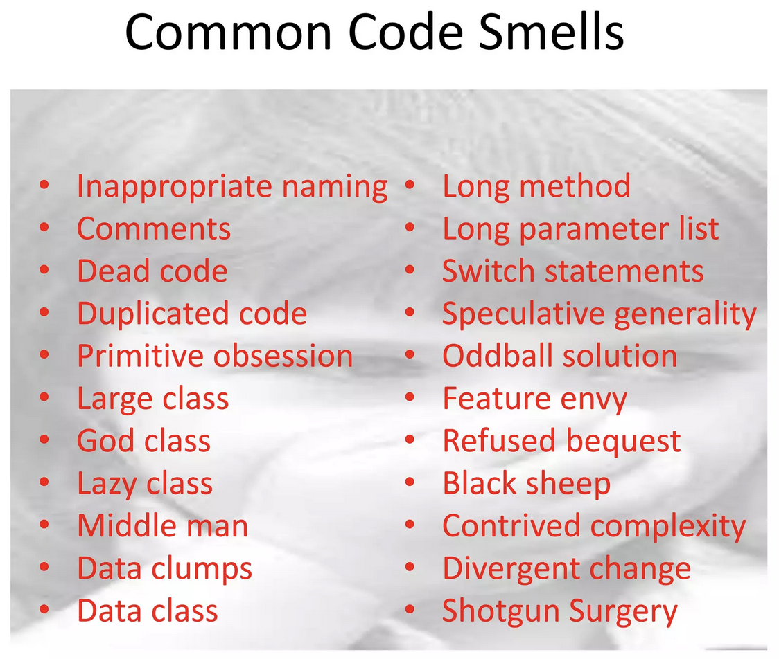

Slide 7
Code Smells
Duplicated Code
bad because if you modify one instance of duplicated code but not the others, you (may) have introduced a bug!
Long Method
long methods are more difﬁcult to understand
performance concerns with respect to lots of short methods are largely obsolete

Slide 8
Code Smells
Large Class
classes try to do too much, which reduces cohesion
Long Parameter List
hard to understand, can become inconsistent
Divergent Change
Related to cohesion: symptom: one type of change requires changing one subset of methods; another type of change requires changing another subset

Slide 9
Code Smells
Lazy Class
A class that no longer “pays its way”
e.g. may be a class that was downsized by a previous refactoring, or represented planned functionality that did not pan out
Speculative Generality
“Oh I think we need the ability to do this kind of thing someday”
Temporary Field
An attribute of an object is only set in certain circumstances; but an object should need all of its attributes
Duplicate code
“Hey I need this snippet elsewhere as well! Wait… lemme just copy-paste!”

Slide 10
Code Smells
Lazy Class
A class that no longer “pays its way”
e.g. may be a class that was downsized by a previous refactoring, or represented planned functionality that did not pan out
Speculative Generality
“Oh I think we need the ability to do this kind of thing someday”
Temporary Field
An attribute of an object is only set in certain circumstances; but an object should need all of its attributes
Duplicate code
“Hey I need this snippet elsewhere as well! Wait… lemme just copy-paste!”

Slide 11
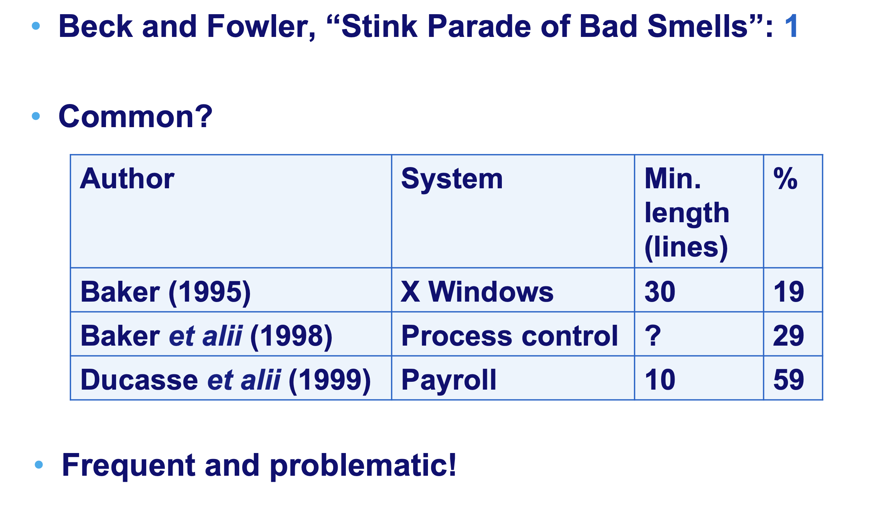
Duplicate Code?

Slide 12

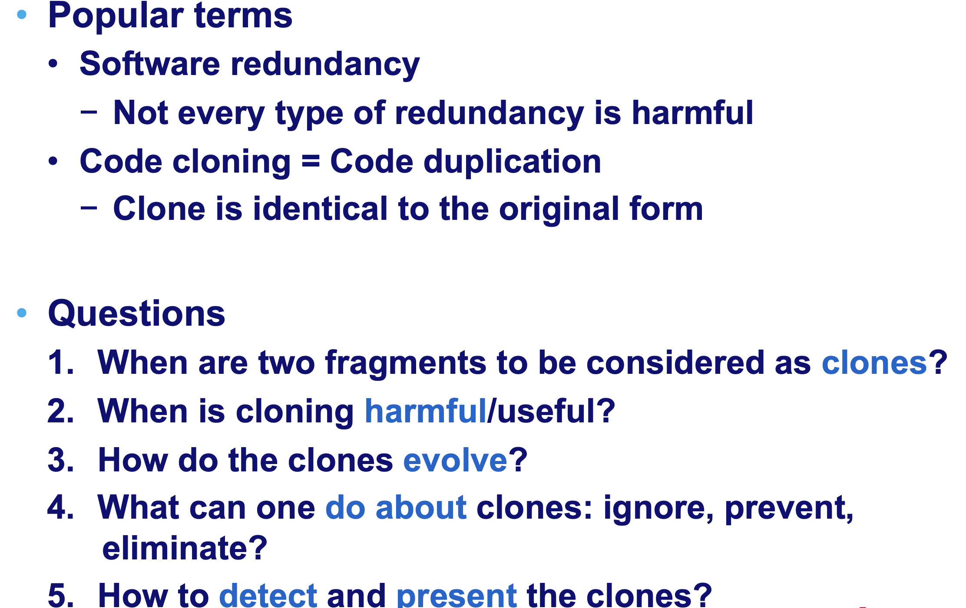
“A rose by any other name…”

Slide 13
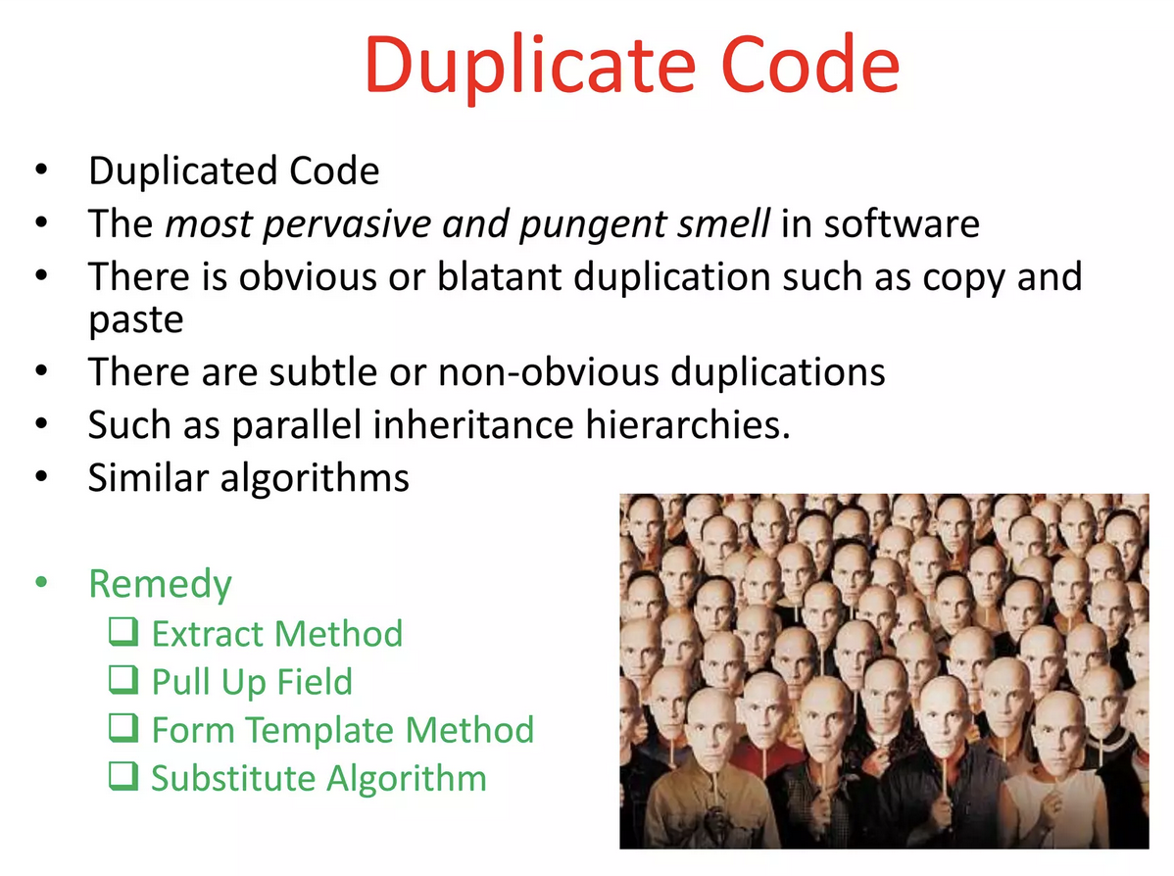

Slide 14
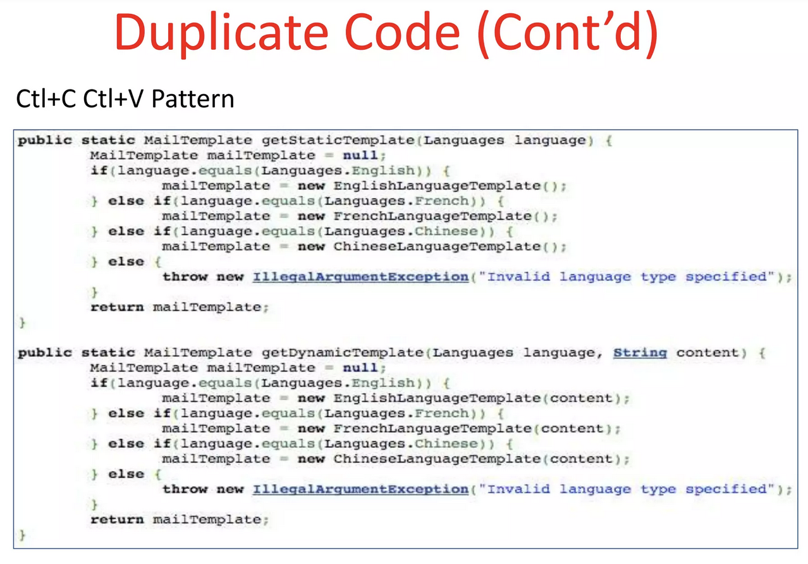

Slide 15
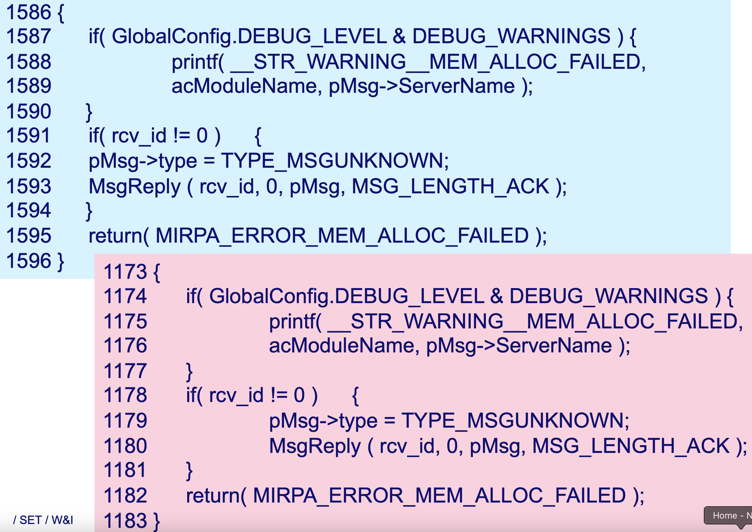

Slide 16
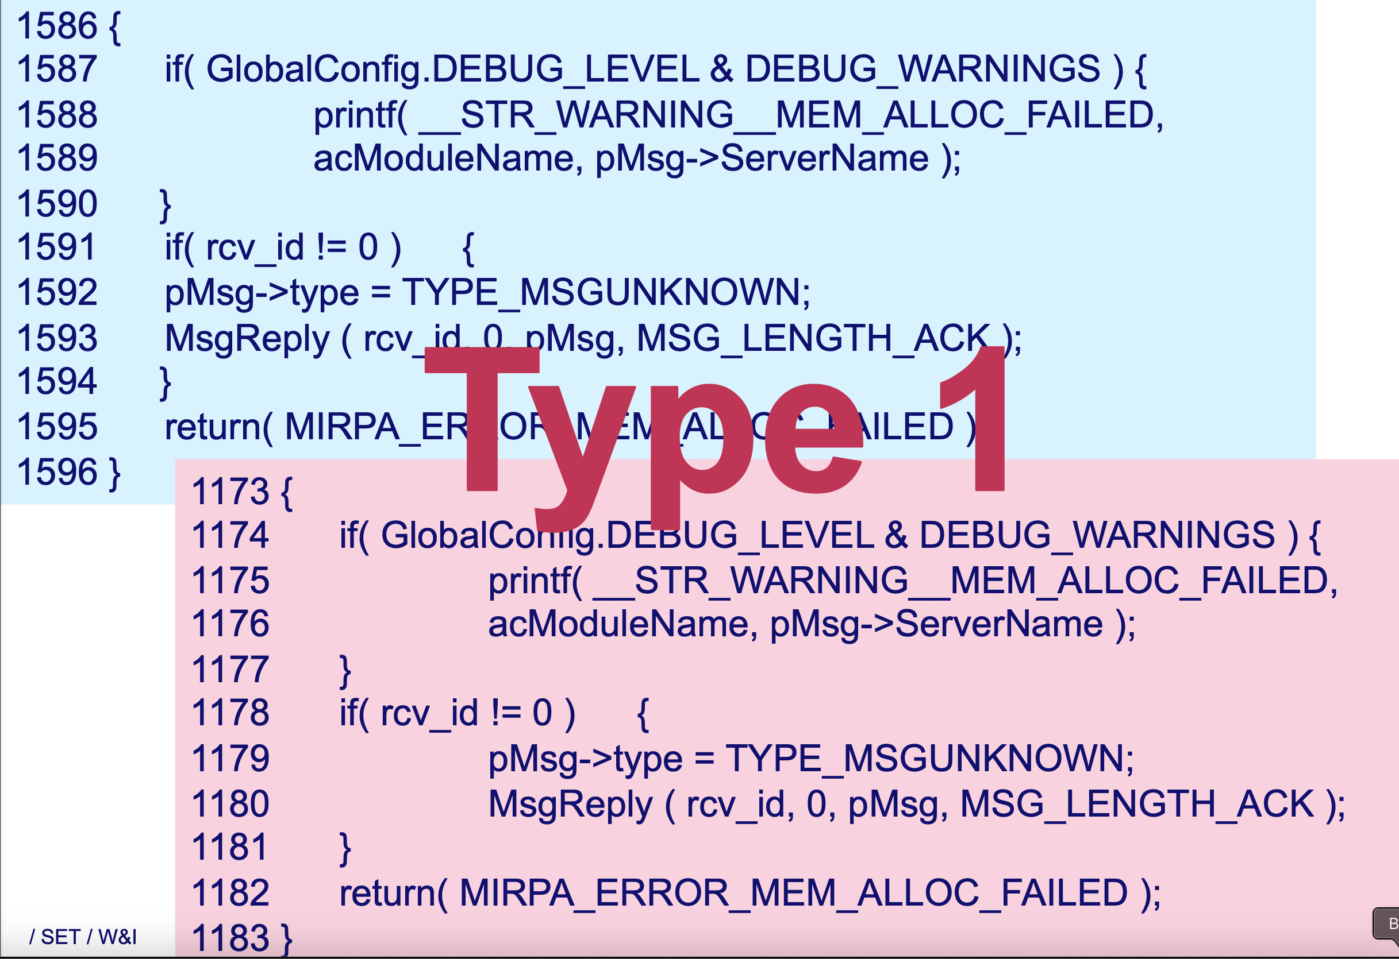

Slide 17
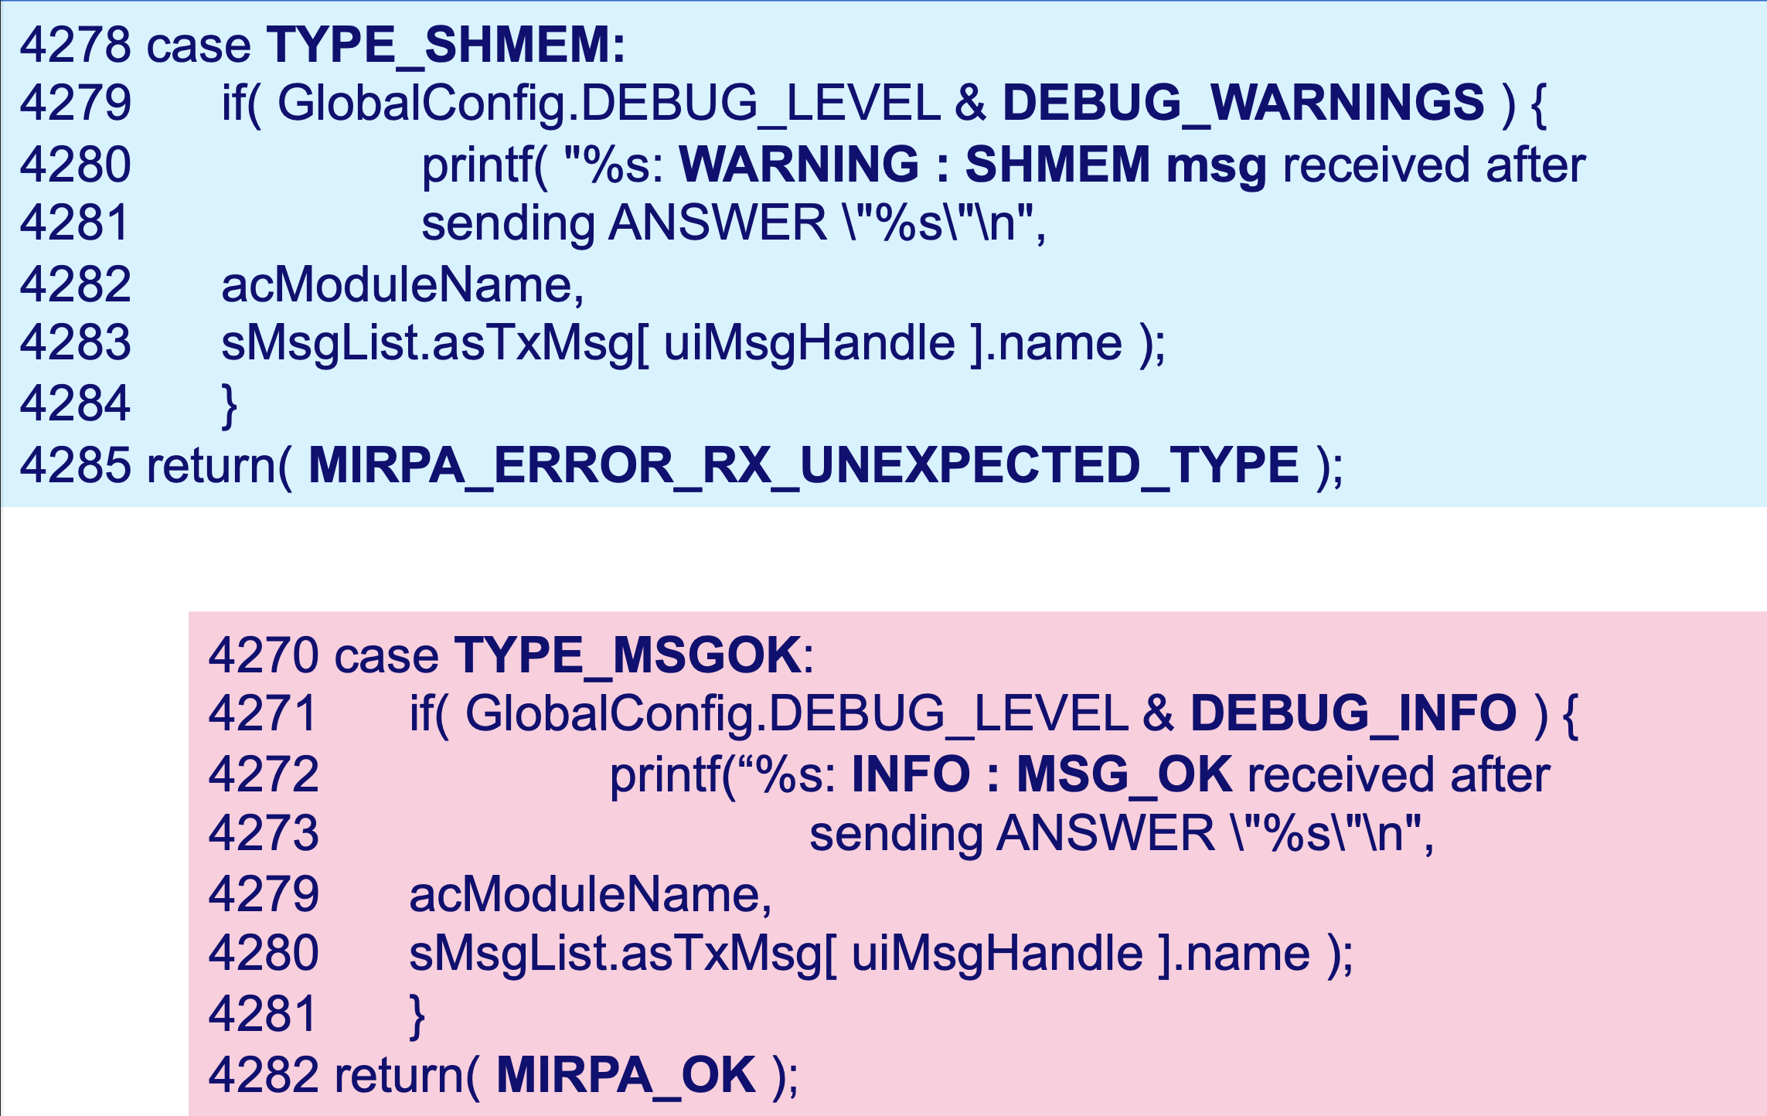

Slide 18
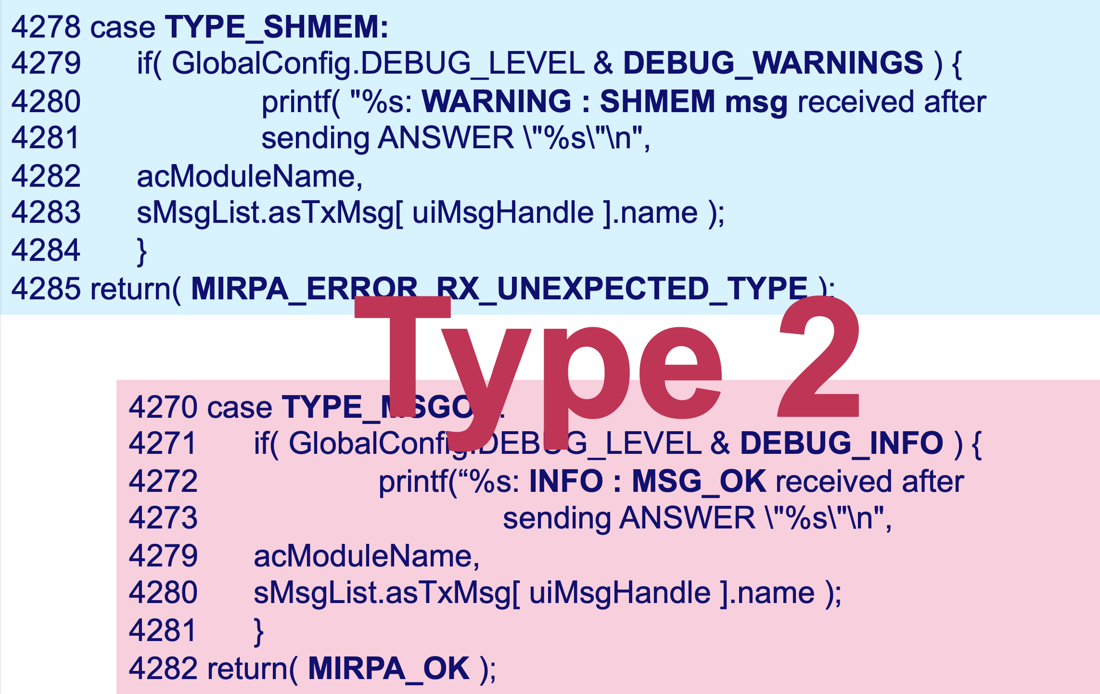

Slide 19
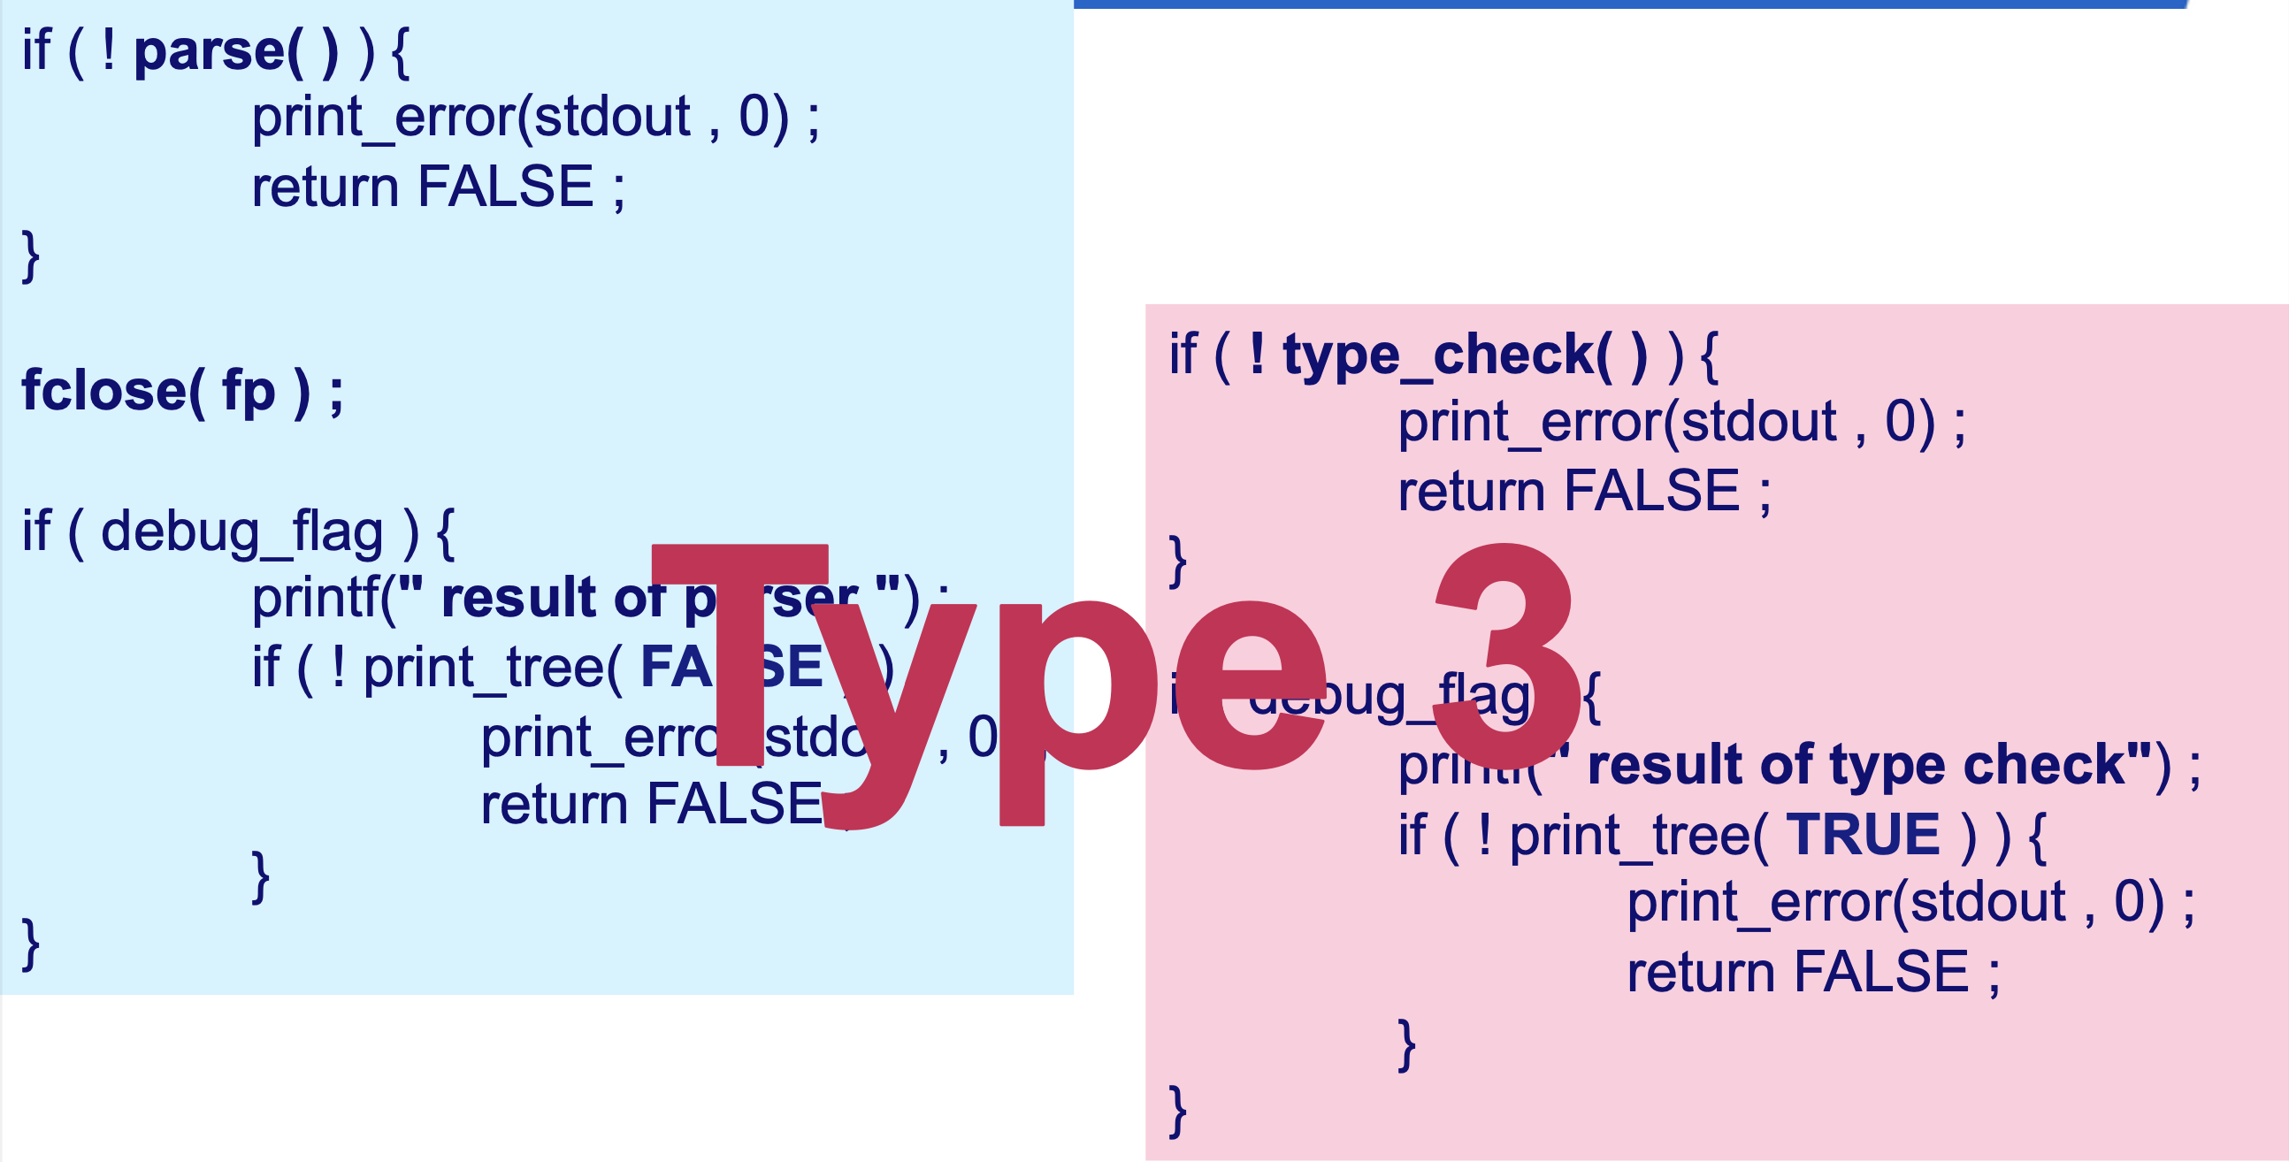

Slide 20
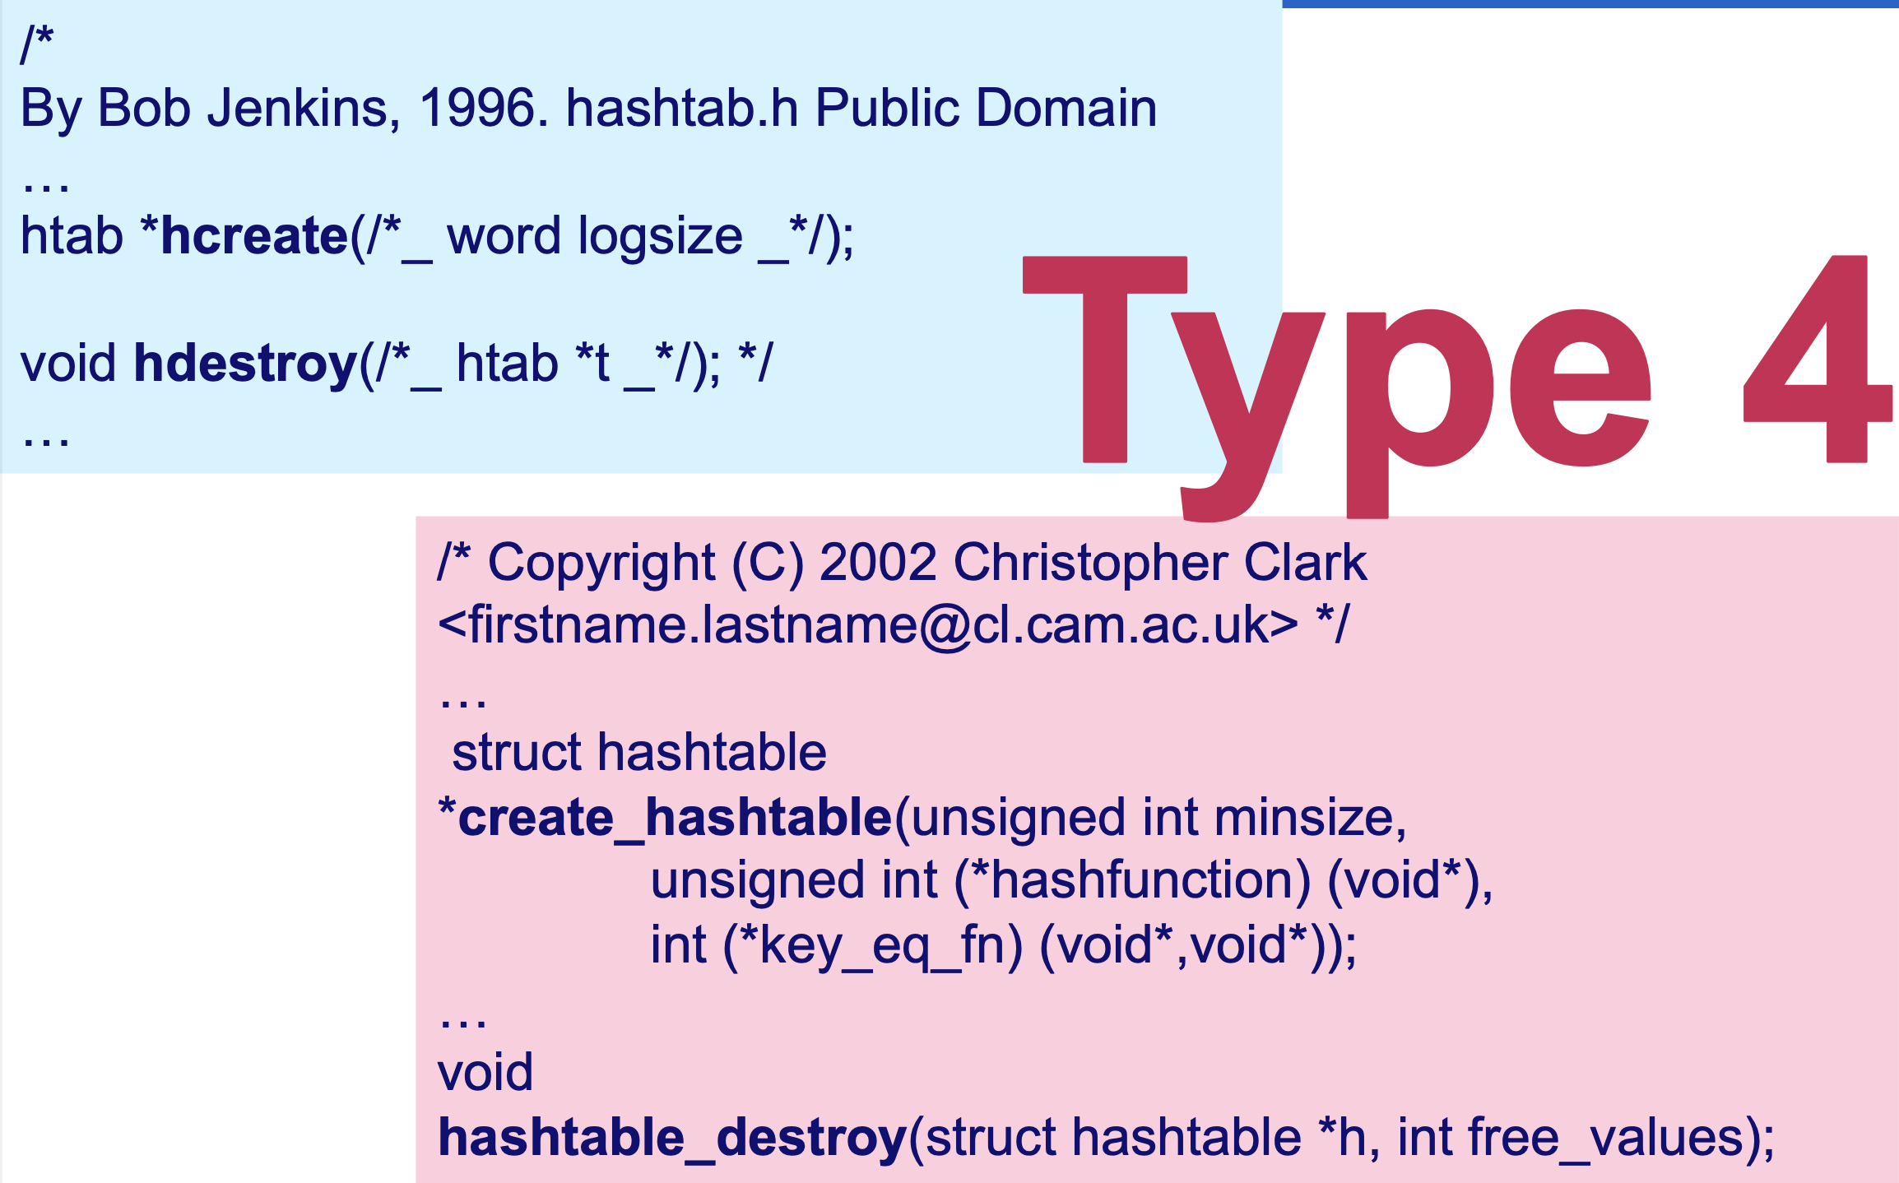

Slide 21
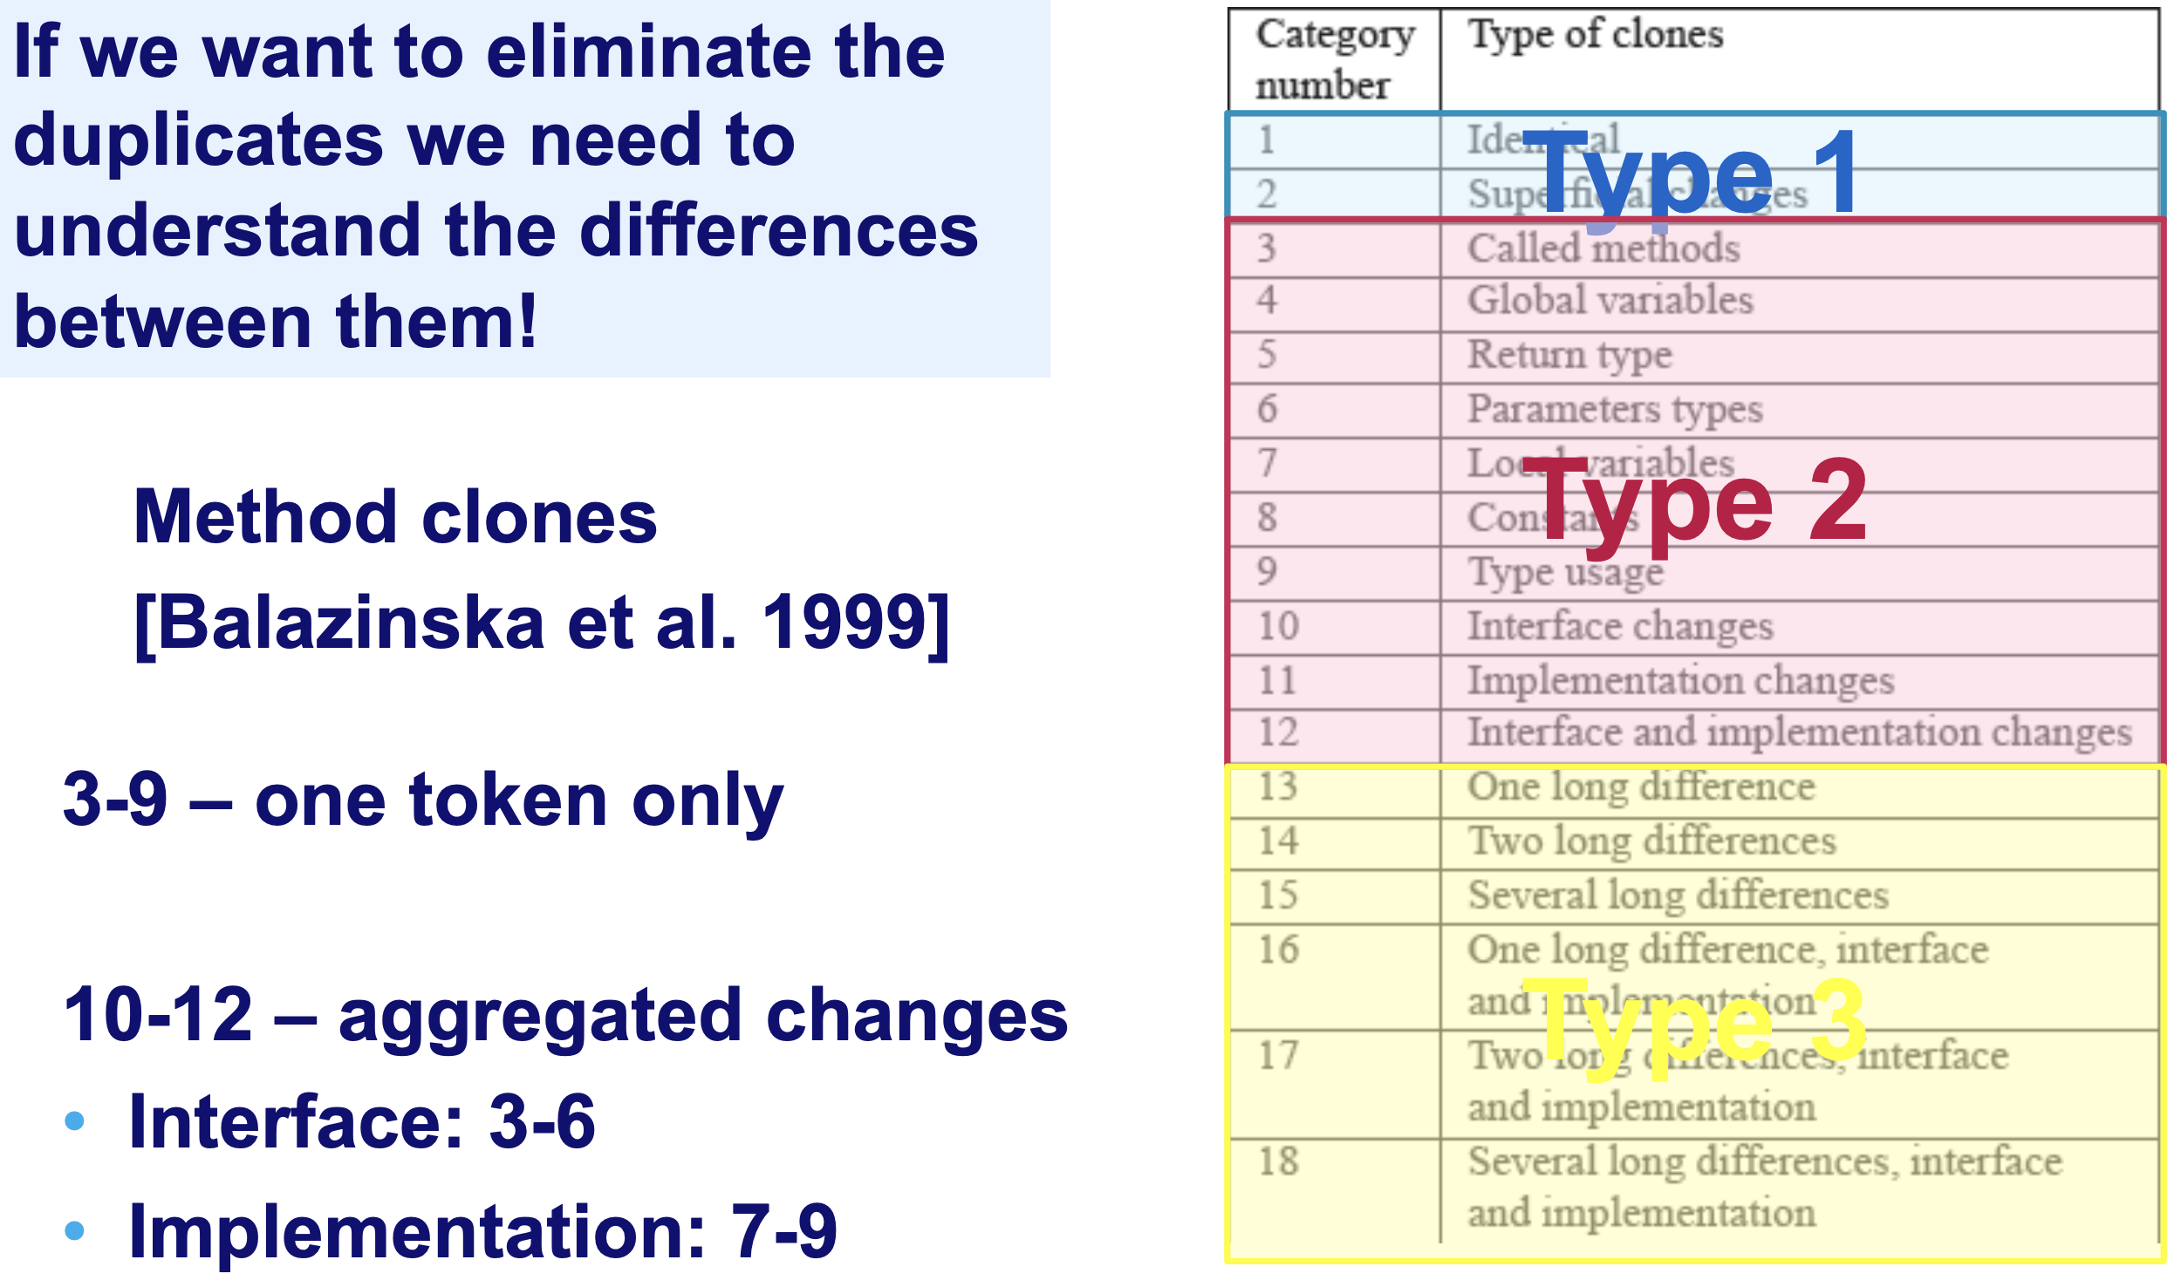
Clones Diagnosis and Elimination

Slide 22
Two fragments are clones if…
Type 1: They are identical up to whitespace/comments;
Type 2: They are structurally identical (rename variables, types or method calls);
Type 3: They are similar but statements/expressions could have been added, removed or modified;
Type 4: They implement the same concepts;
Alternative classifications have been proposed:
[Balazinska et al. 1999] based on the differences
[Kapser et al. 2003] based on the location

Slide 23
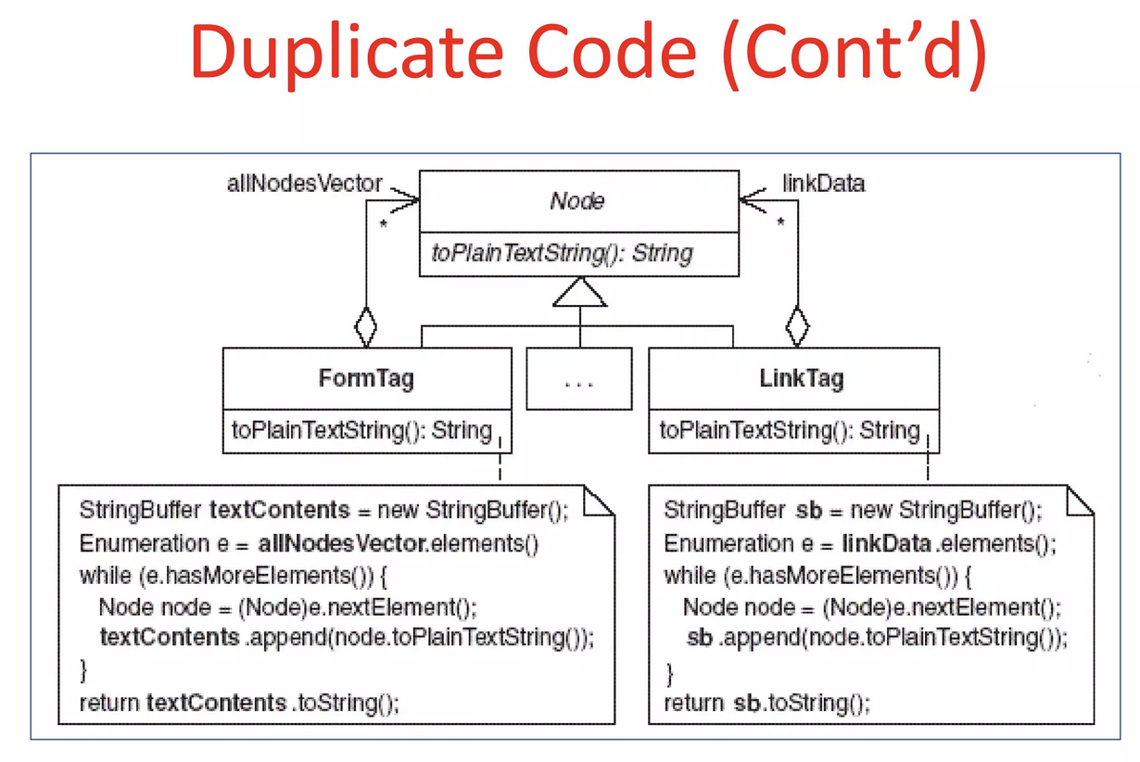

Slide 24
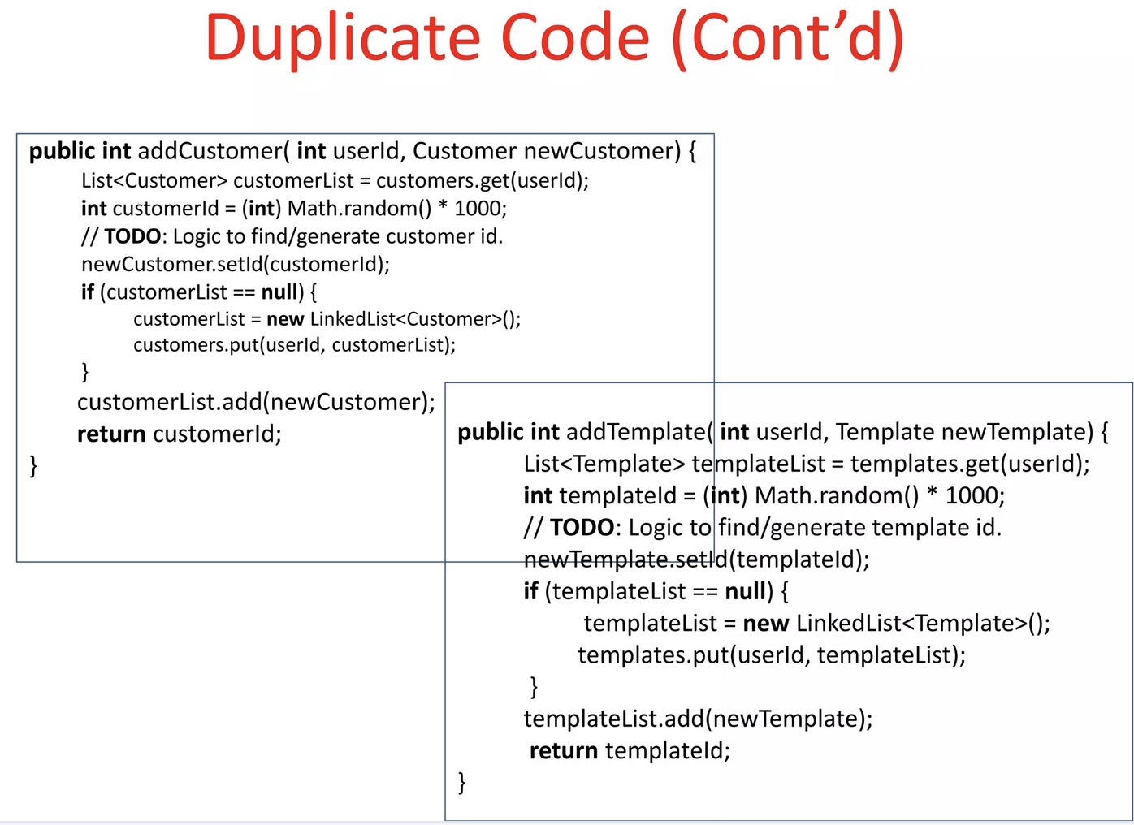

Slide 25
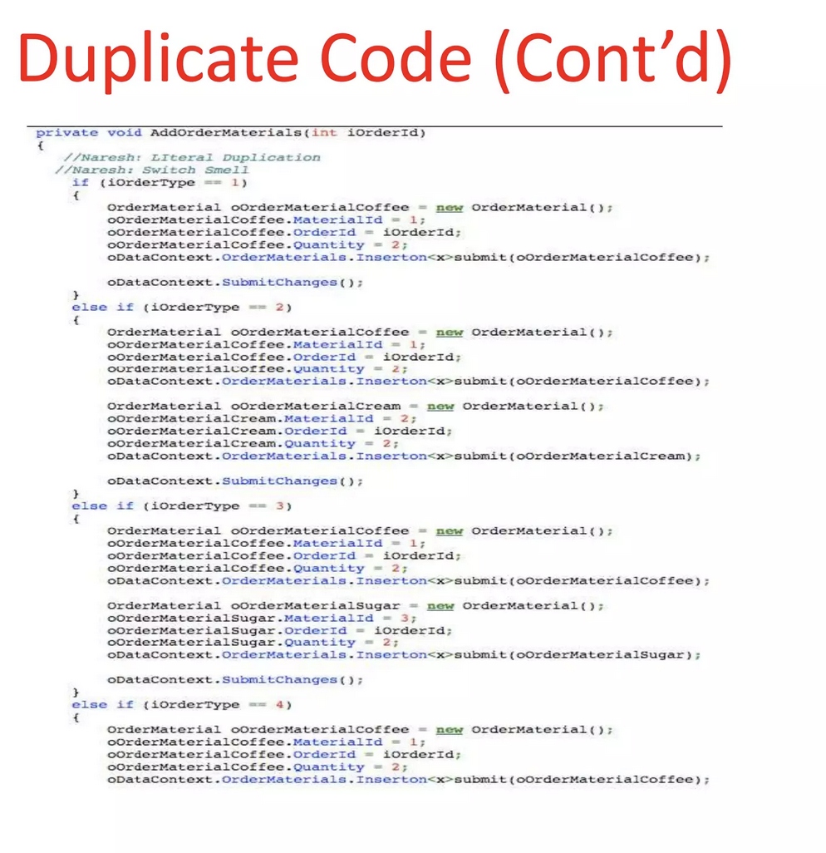

Slide 26
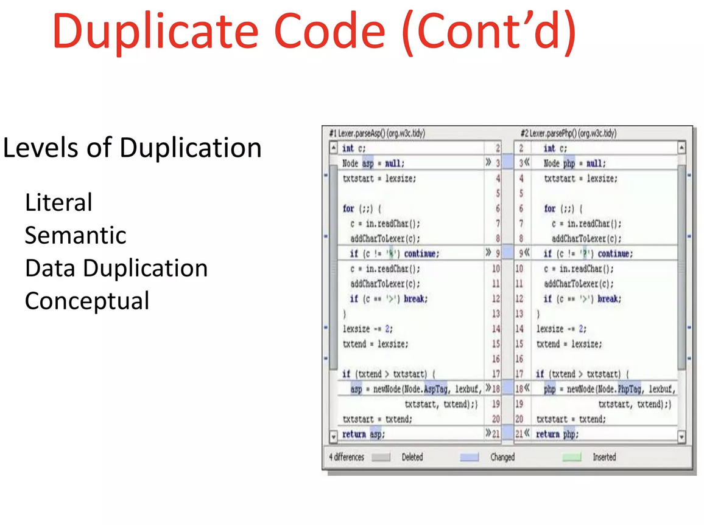

Slide 27
Btw, Is cloning always bad? Good reasons for cloning
Improves reliability
n-version programming, IEC 61508
Reduces development time
“Copy and modify” is faster than “generalize”
Avoids breaking the existing code
Re-testing effort might be prohibitive
Clarifies structure
E.g., disentangles dependencies (but do not overdo it!)
By lack of choice
Programming language does not provide appropriate flexibility mechanisms

Slide 28
Bad news…
More code
More effort required to comprehend, test and modify
Higher resource usage
Interrelated code
Bug duplication
Incomplete or inconsistent updates
Indicative of
Poor or decaying architecture
Lack of appropriate knowledge sharing between the developers

Slide 29
More Bad news…
[Monden et al. 2002]
2000 modules, 1MLOC Cobol
Most errors in modules with ≥ 200 LOC cloned
Many errors in modules with ≤ 50 LOC cloned
Least errors in modules with 50-100 LOC clones
No explanation of this phenomenon
[Chou et al. 2001]
Linux and Open BSD kernels
In presence of clones: one error ⇒ many errors

Slide 30
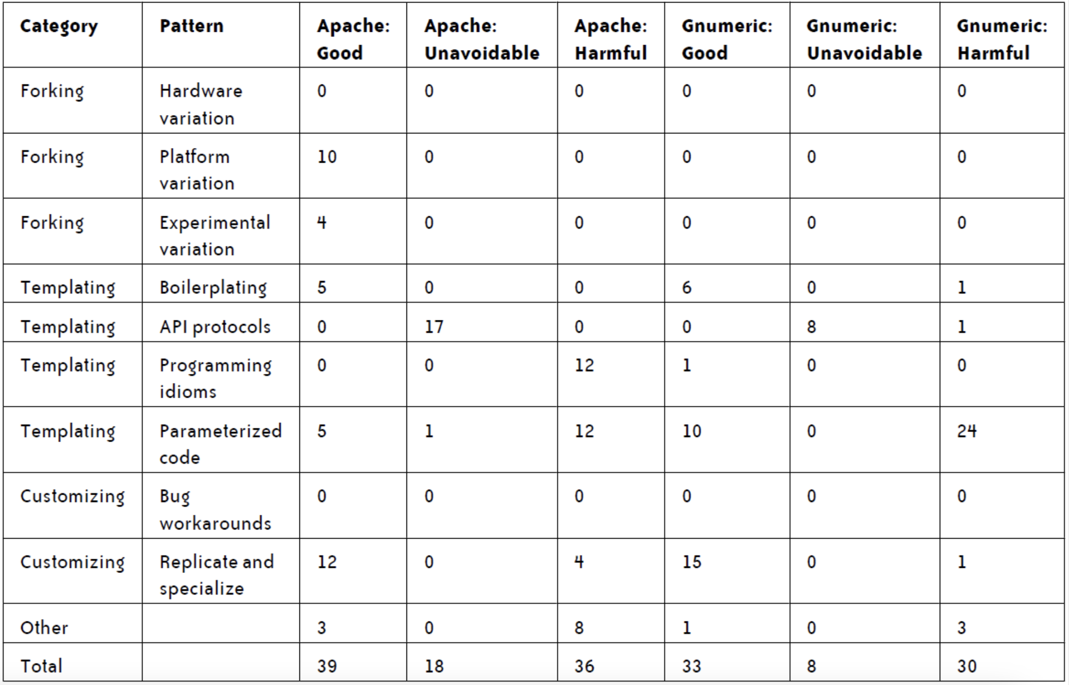
How harmful is cloning? *
*[Godfrey, Kapser, 2011]

Slide 31
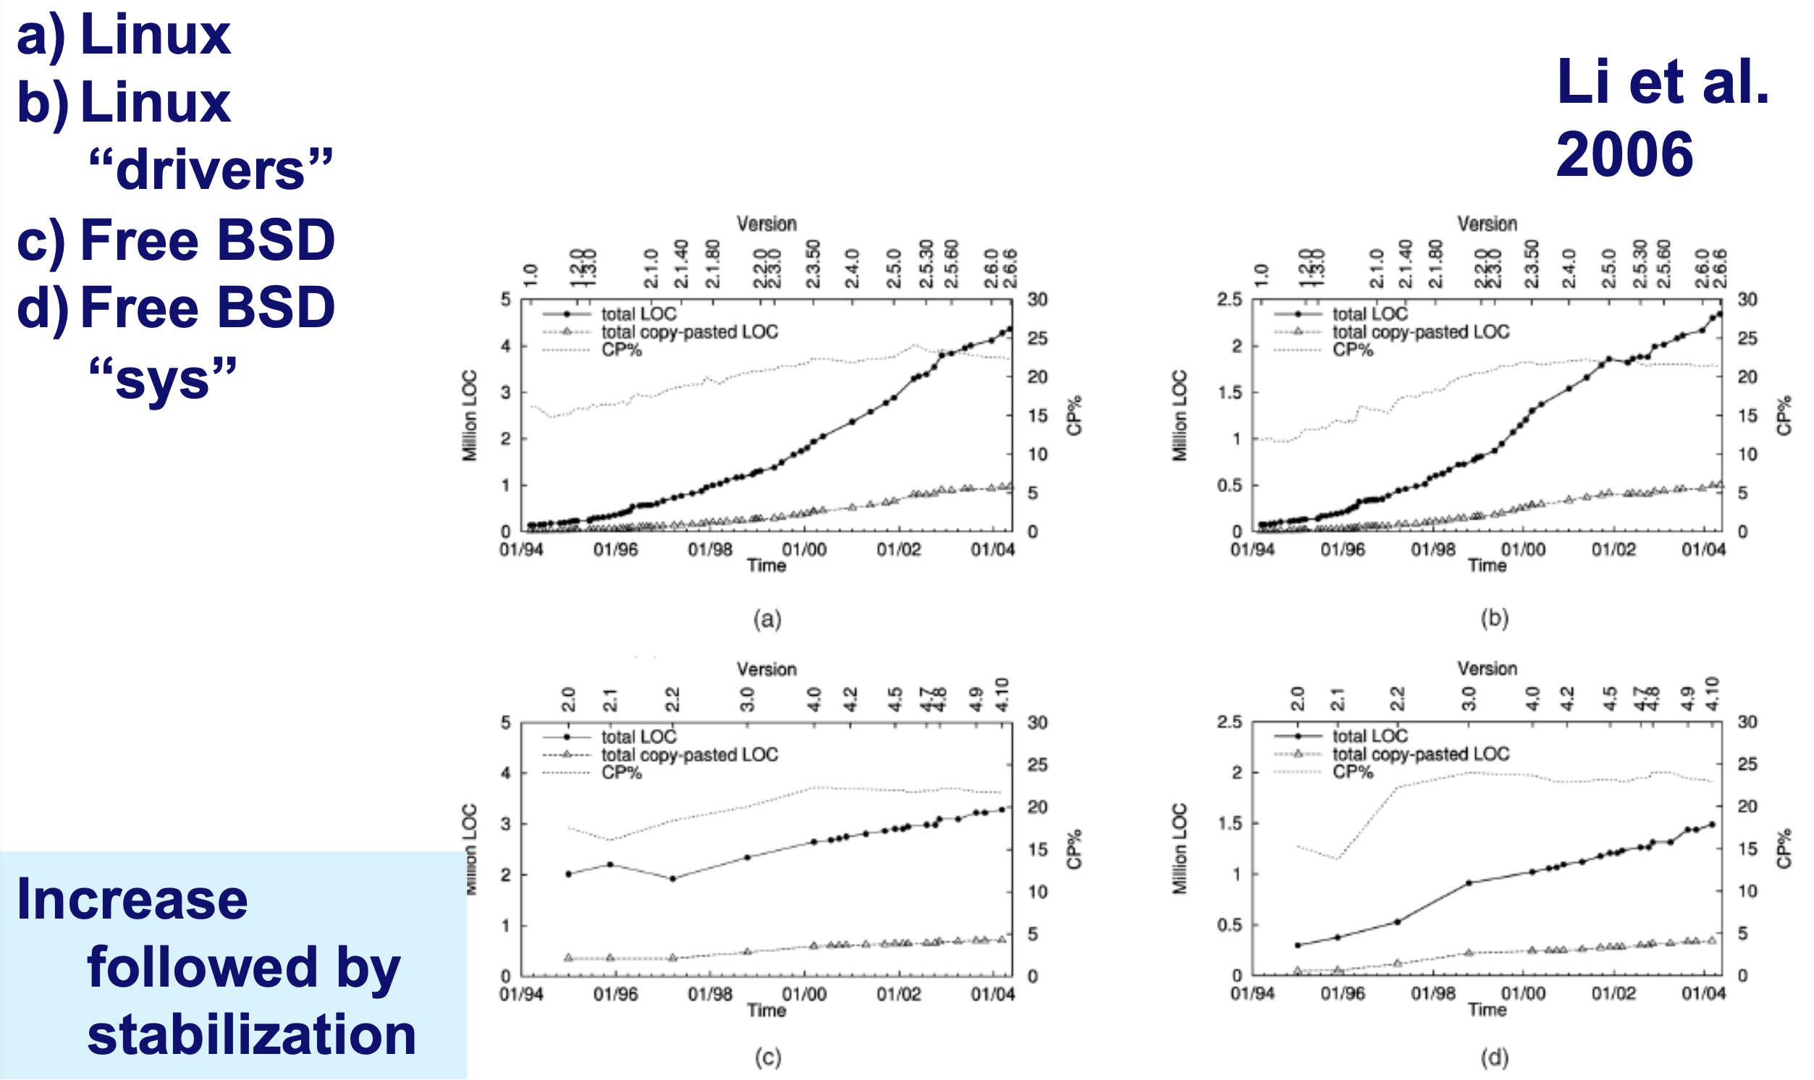
Do clones evolve?

Slide 32
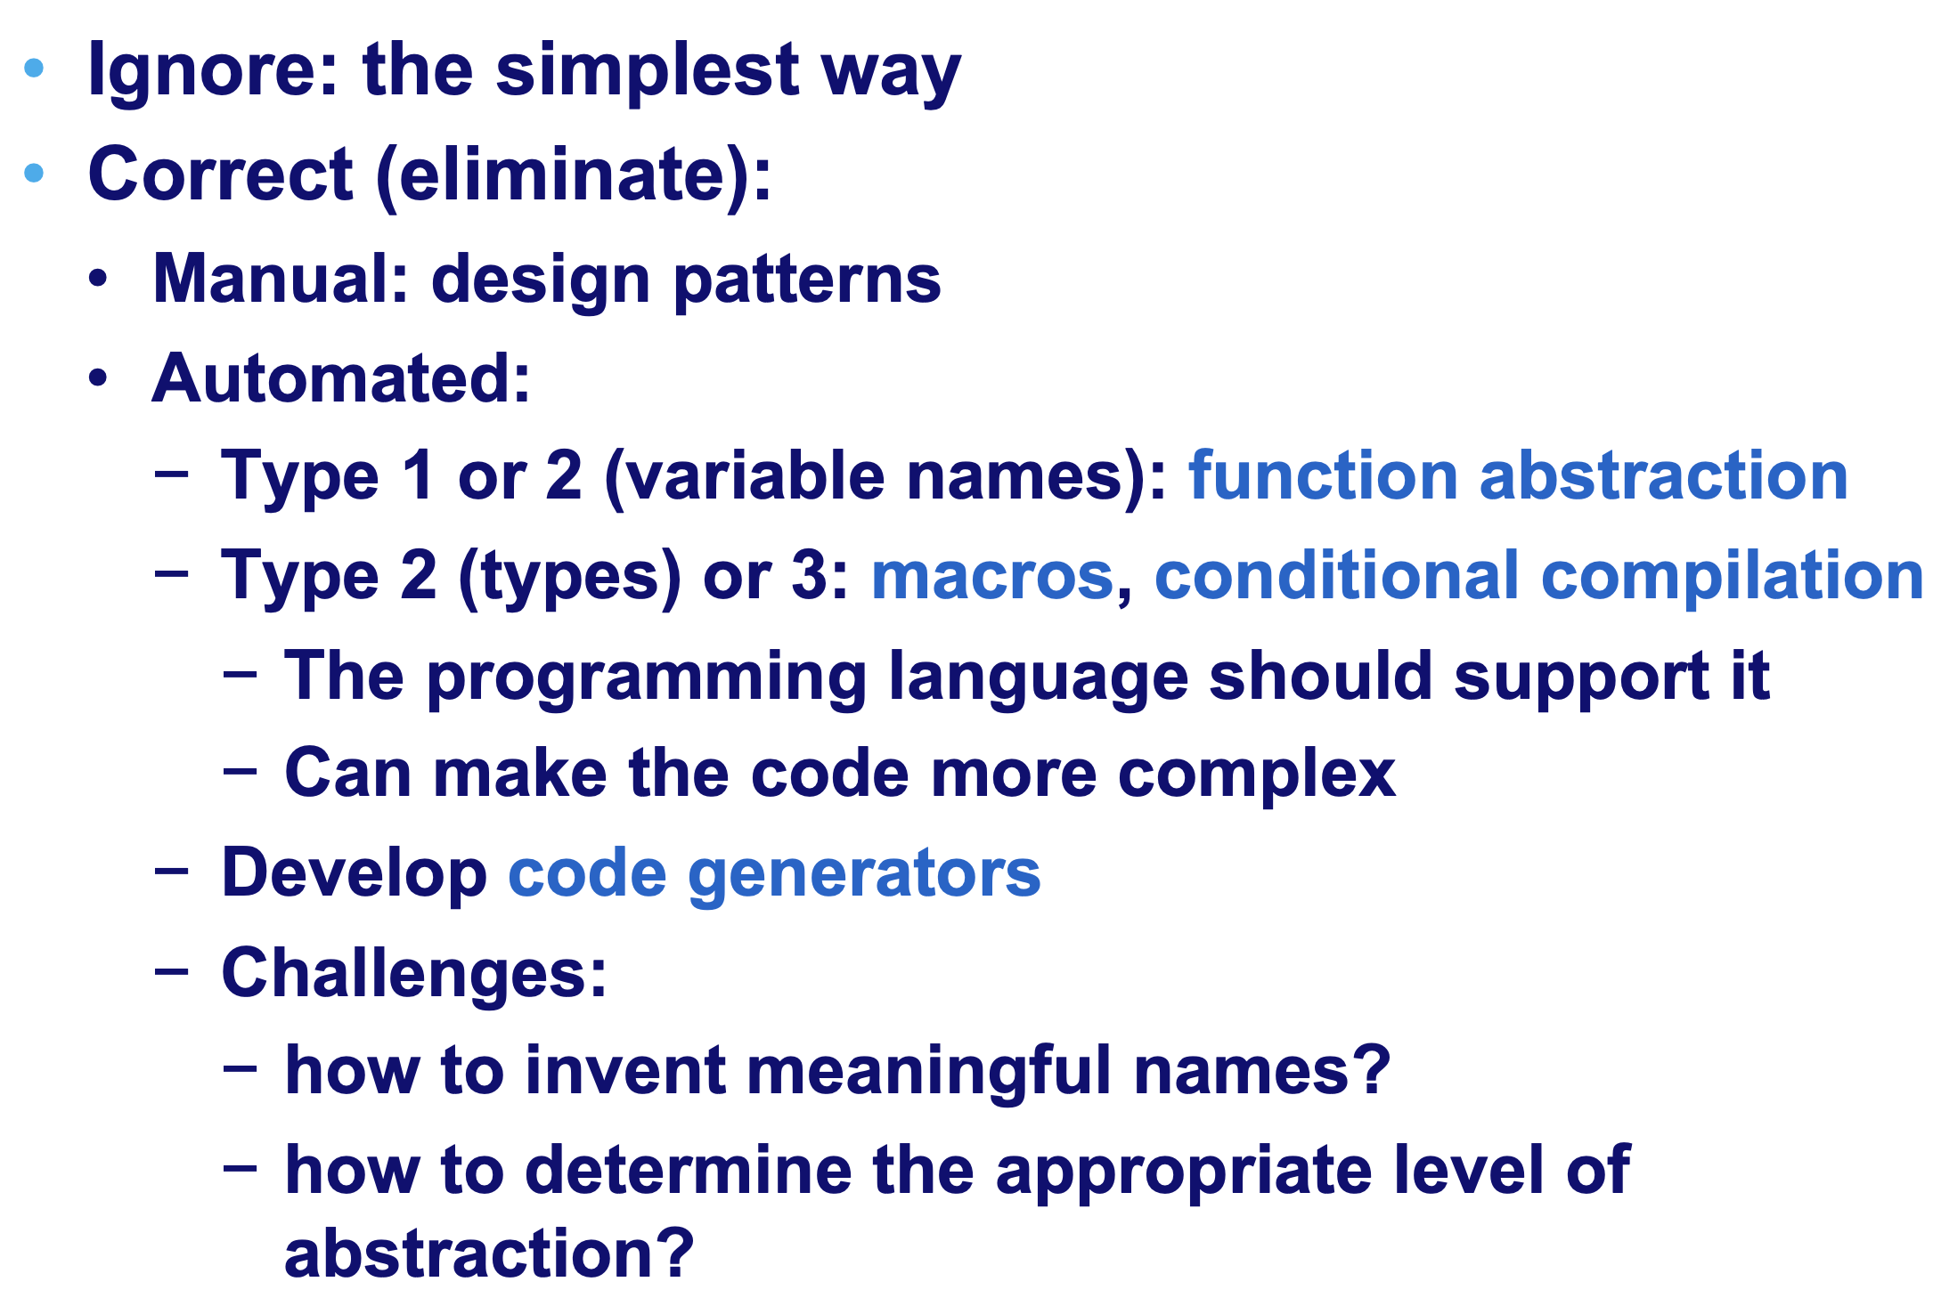
What can we do about clones?

Slide 33
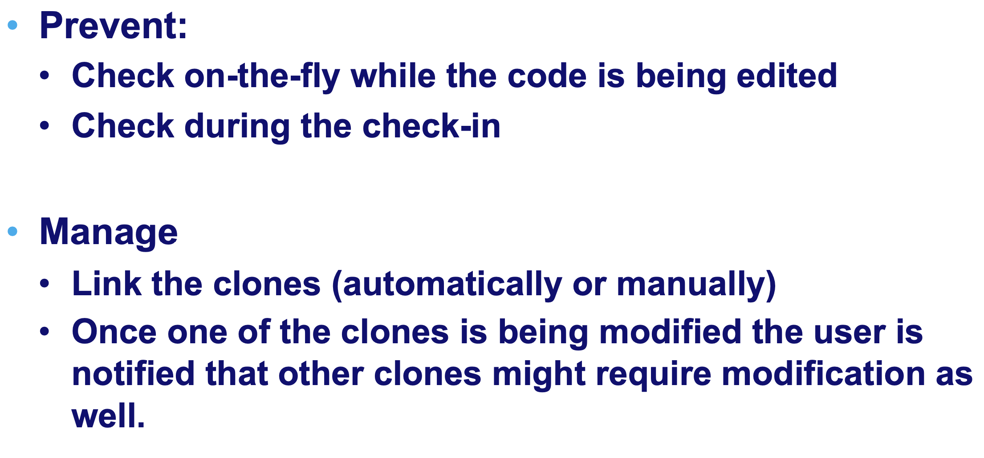
What can we do about clones? (cont’d)

Slide 34
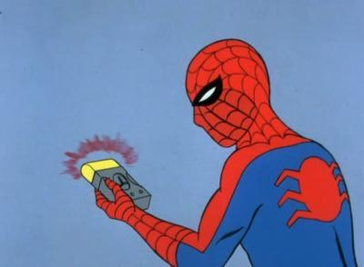
What can we do about clones? (cont’d)
DETECT!

Slide 35
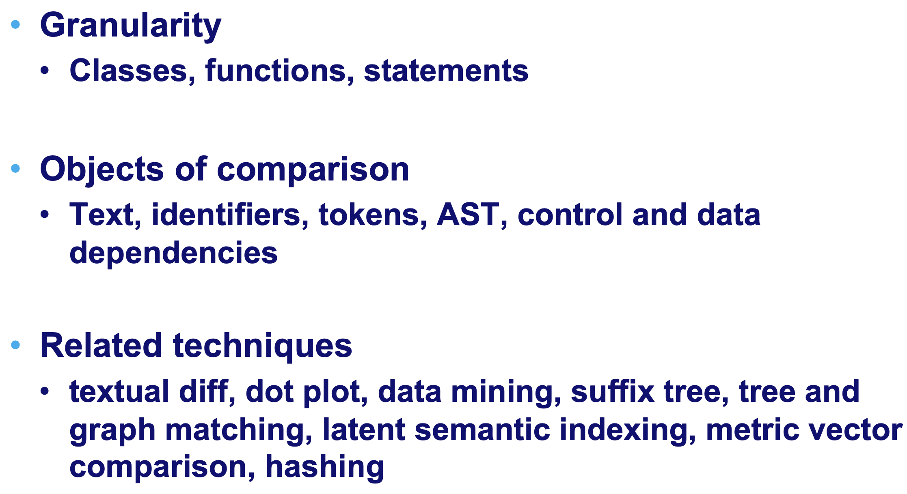
What can we do about clones? (cont’d)

Slide 36
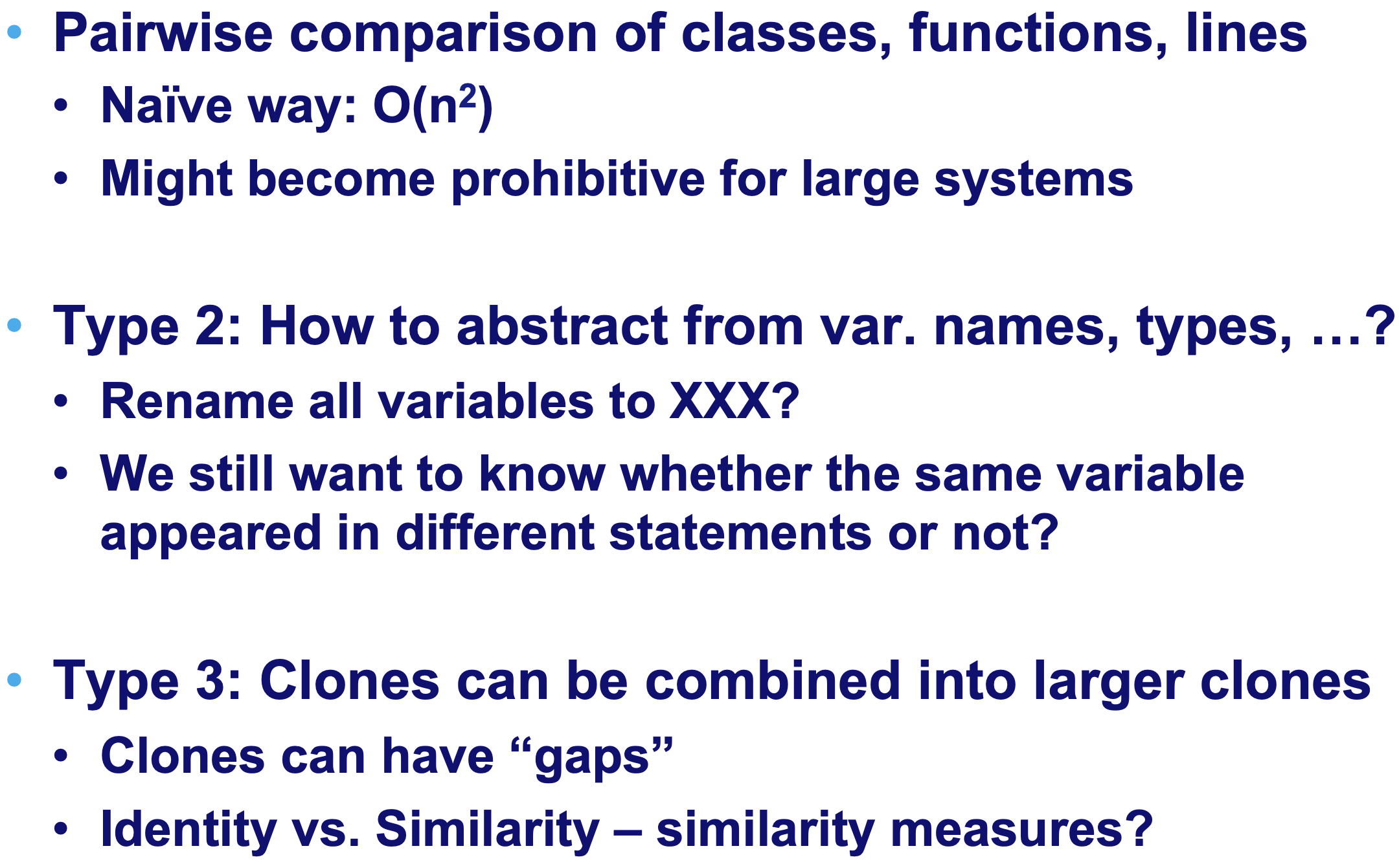
What can we do about clones? (cont’d)

Slide 37


Slide 38
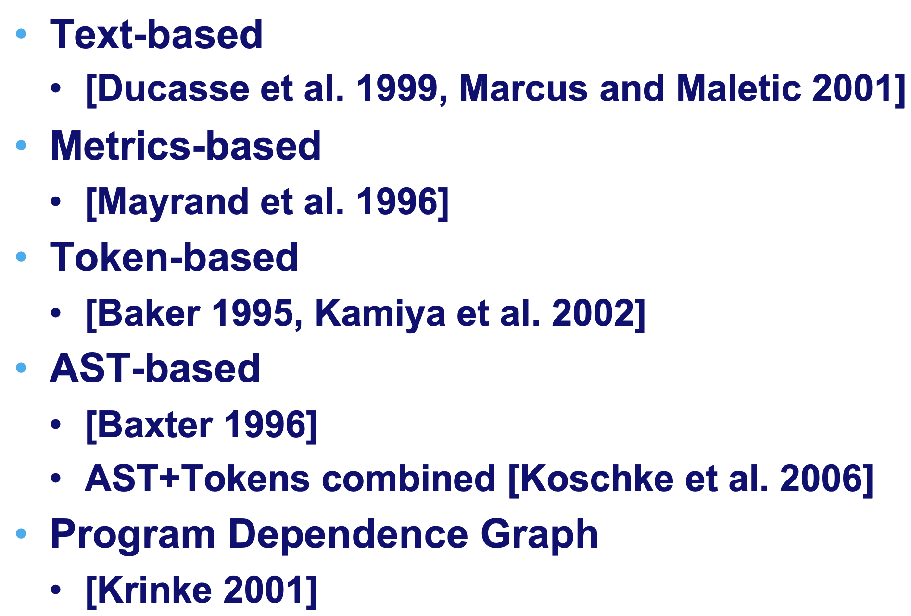
Clone detection techniques (so far)

Slide 39
Clone detection techniques (so far)

Slide 40
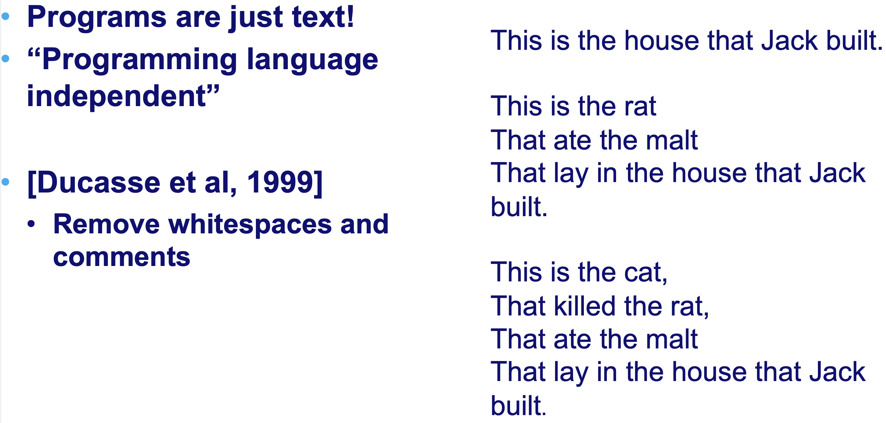
Text-based

Slide 41
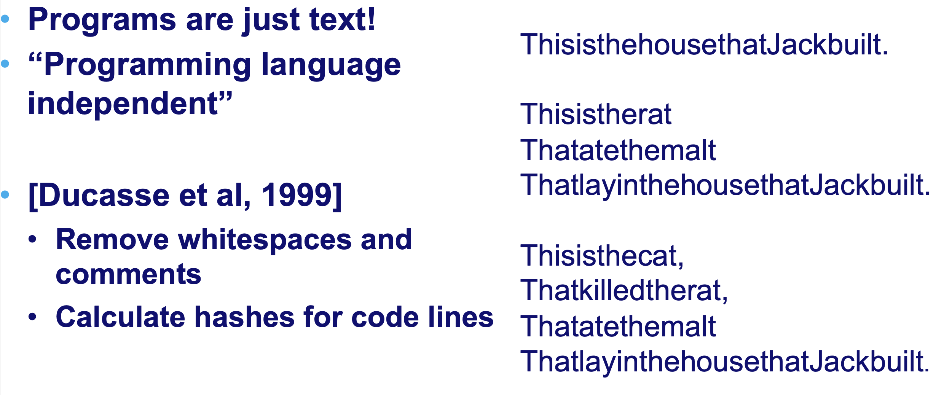
Text-based (cont’d)

Slide 42
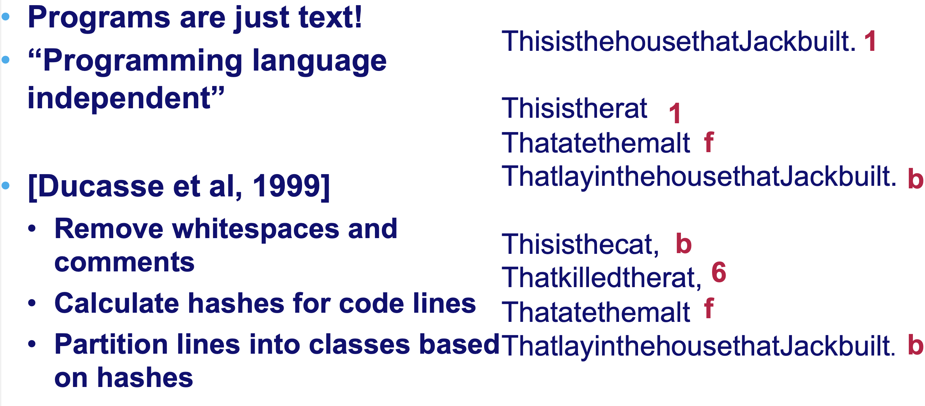
Text-based (cont’d)

Slide 43
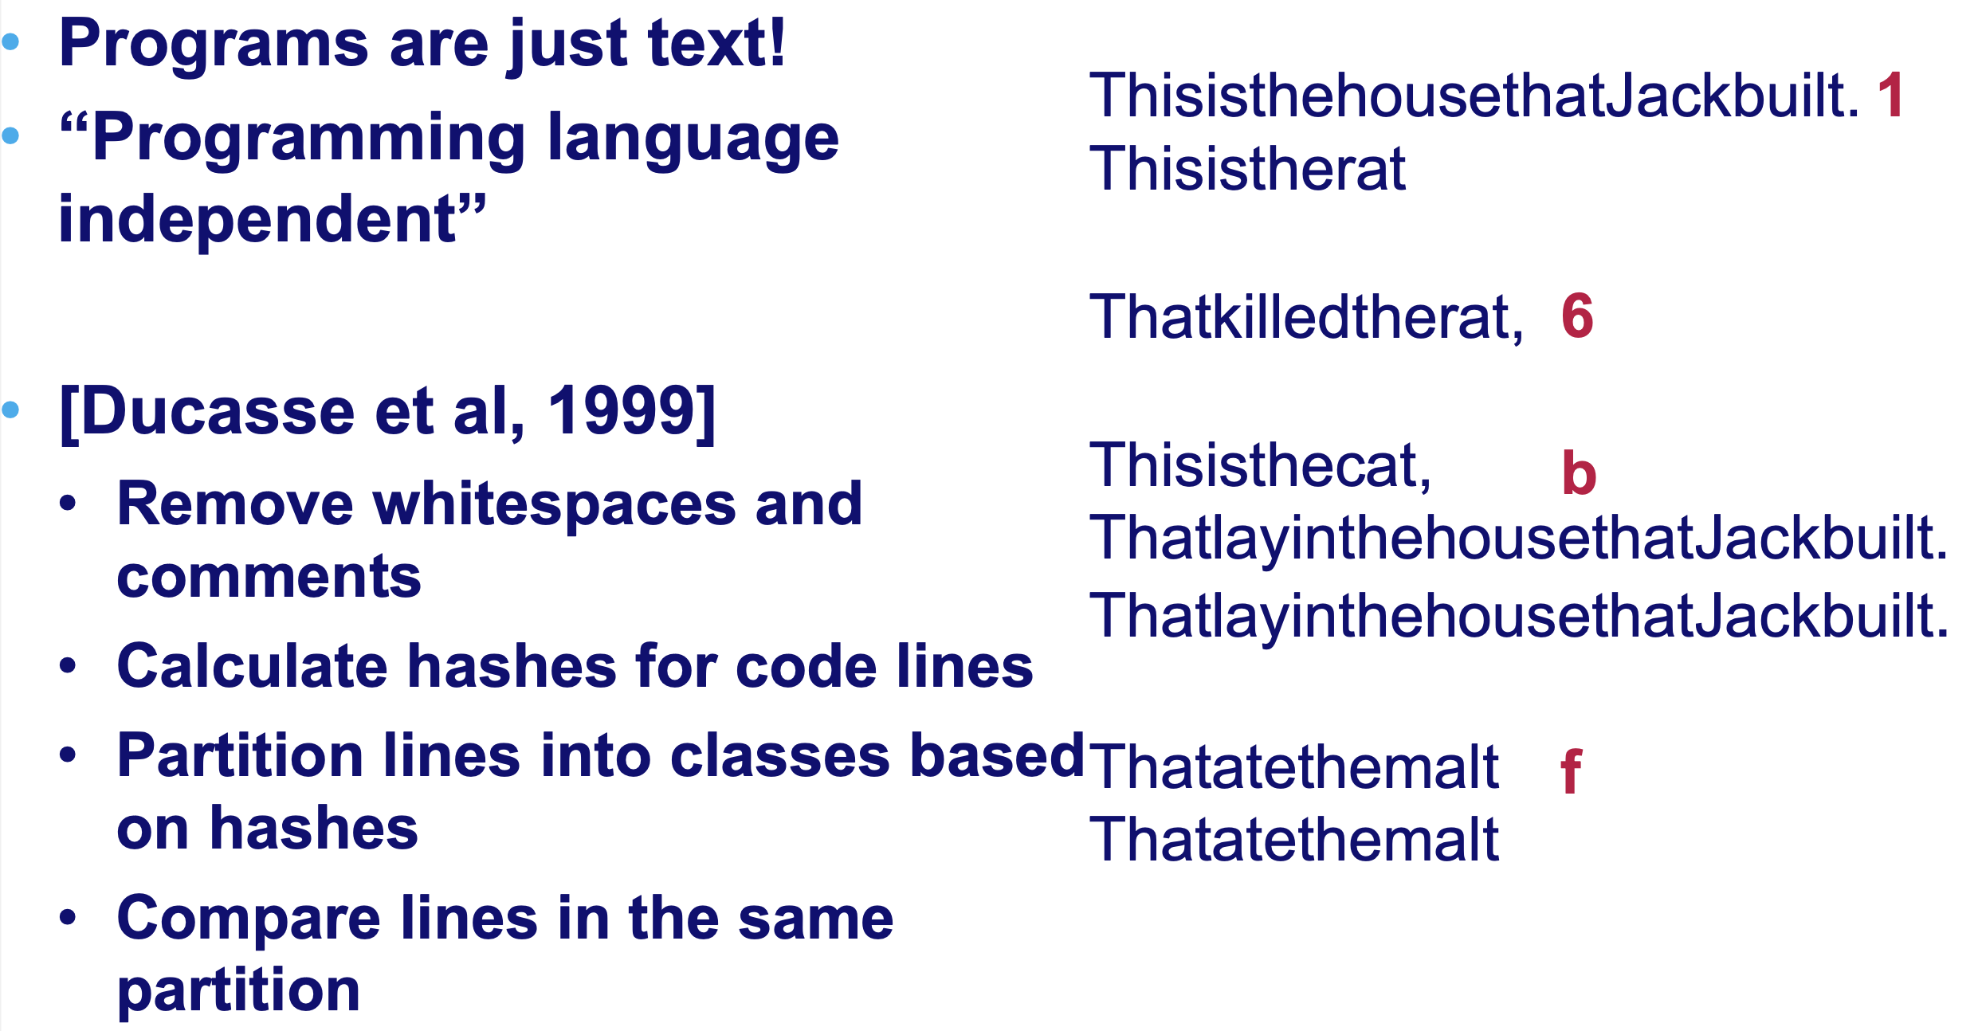
Text-based (cont’d)

Slide 44
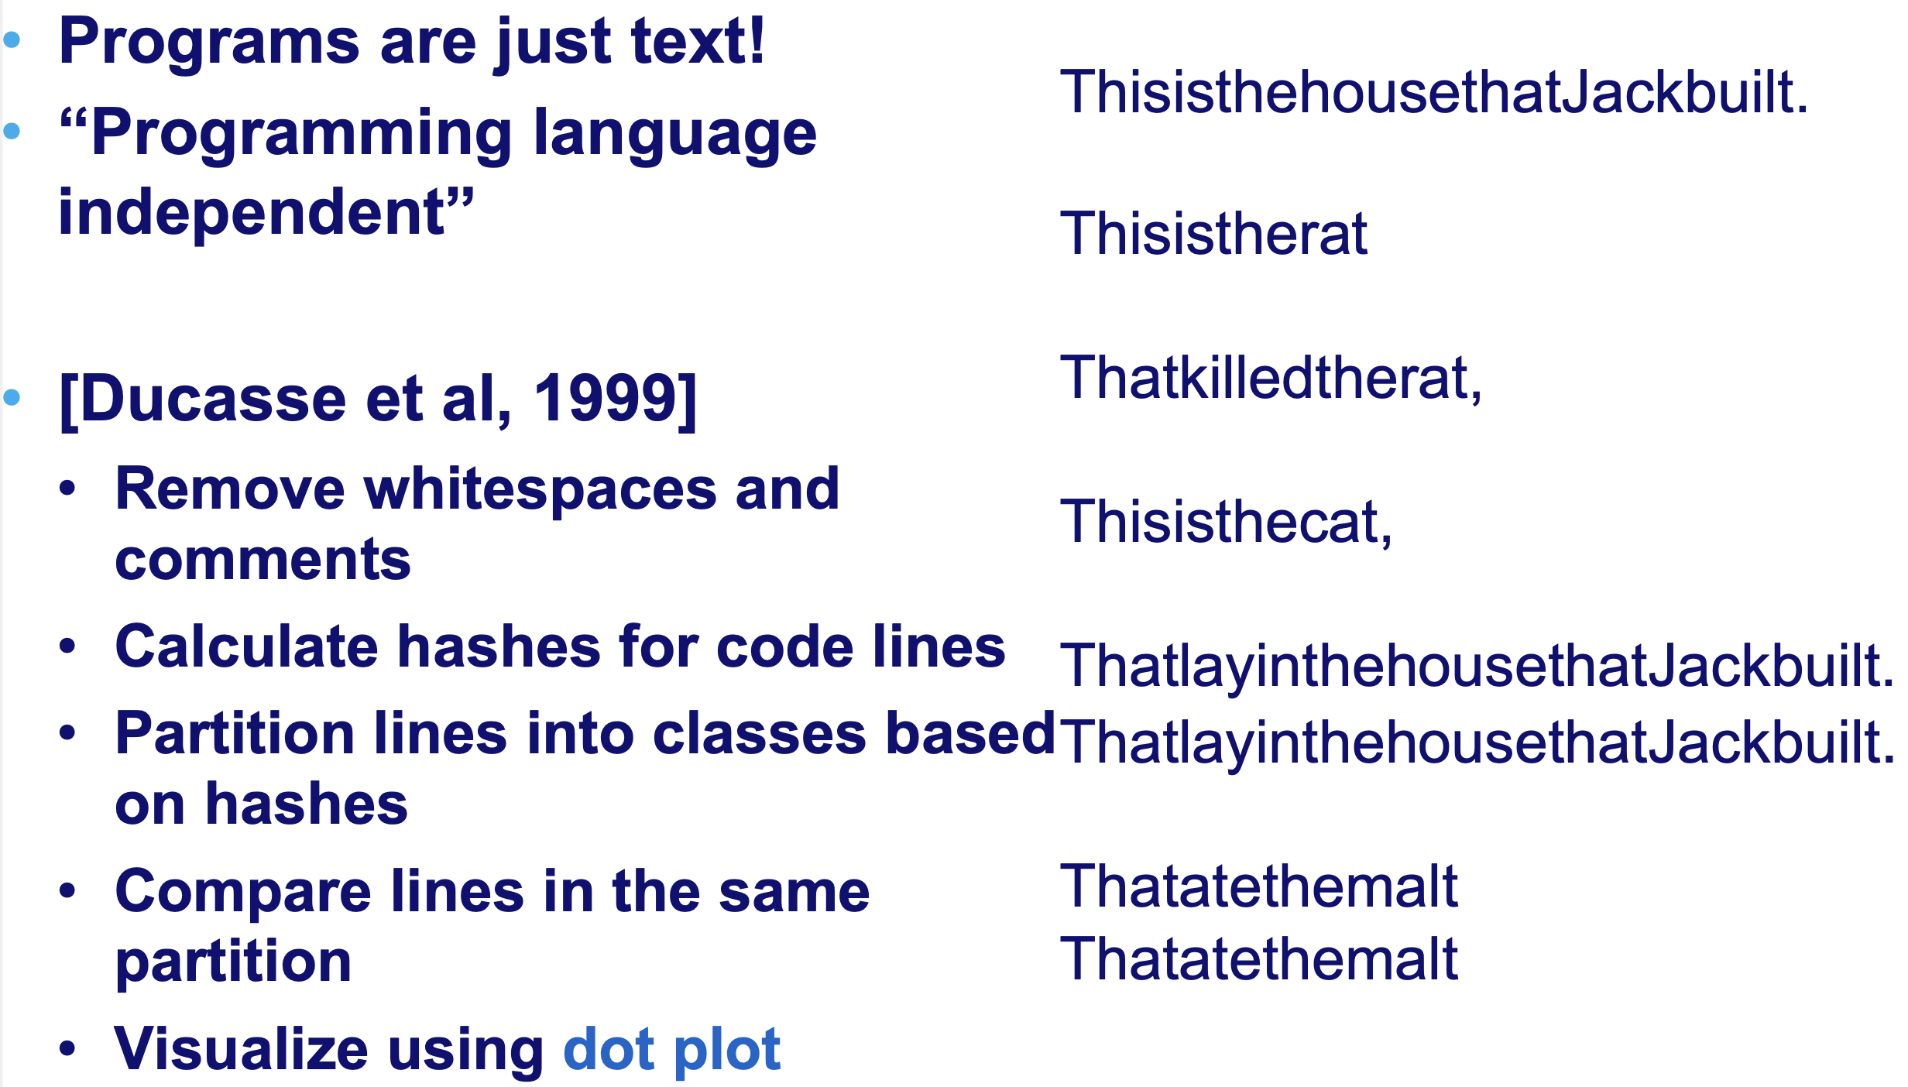
Text-based (cont’d)

Slide 45
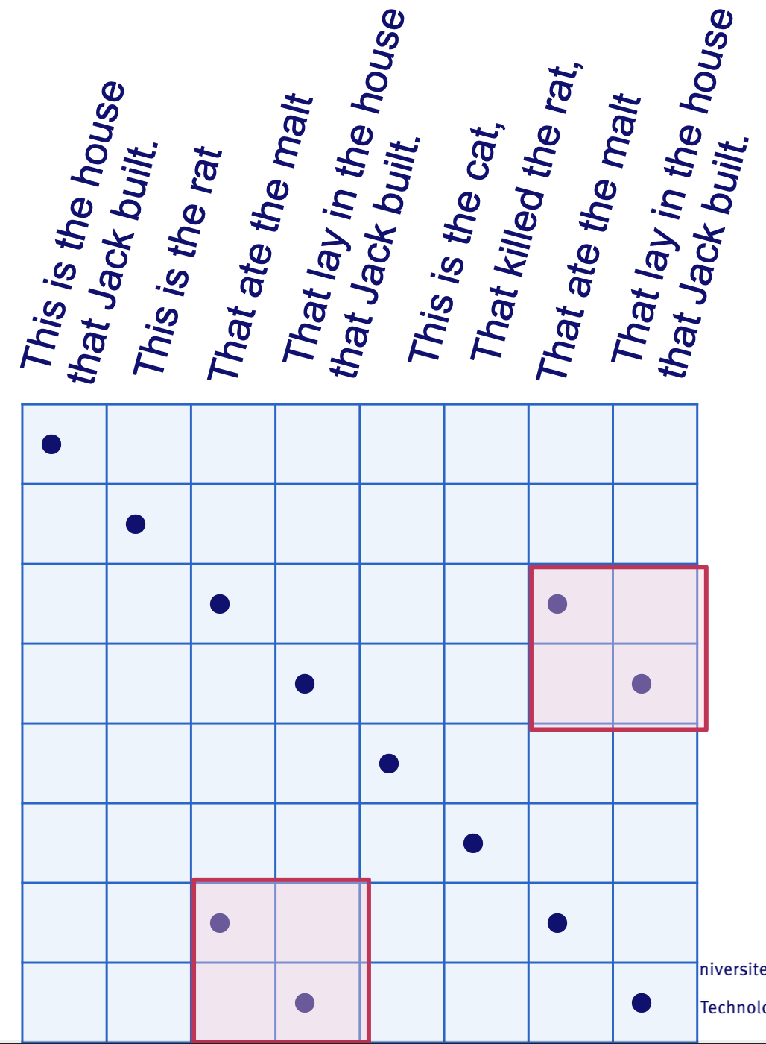
Recognize larger clones by dot plot patterns!

Slide 46
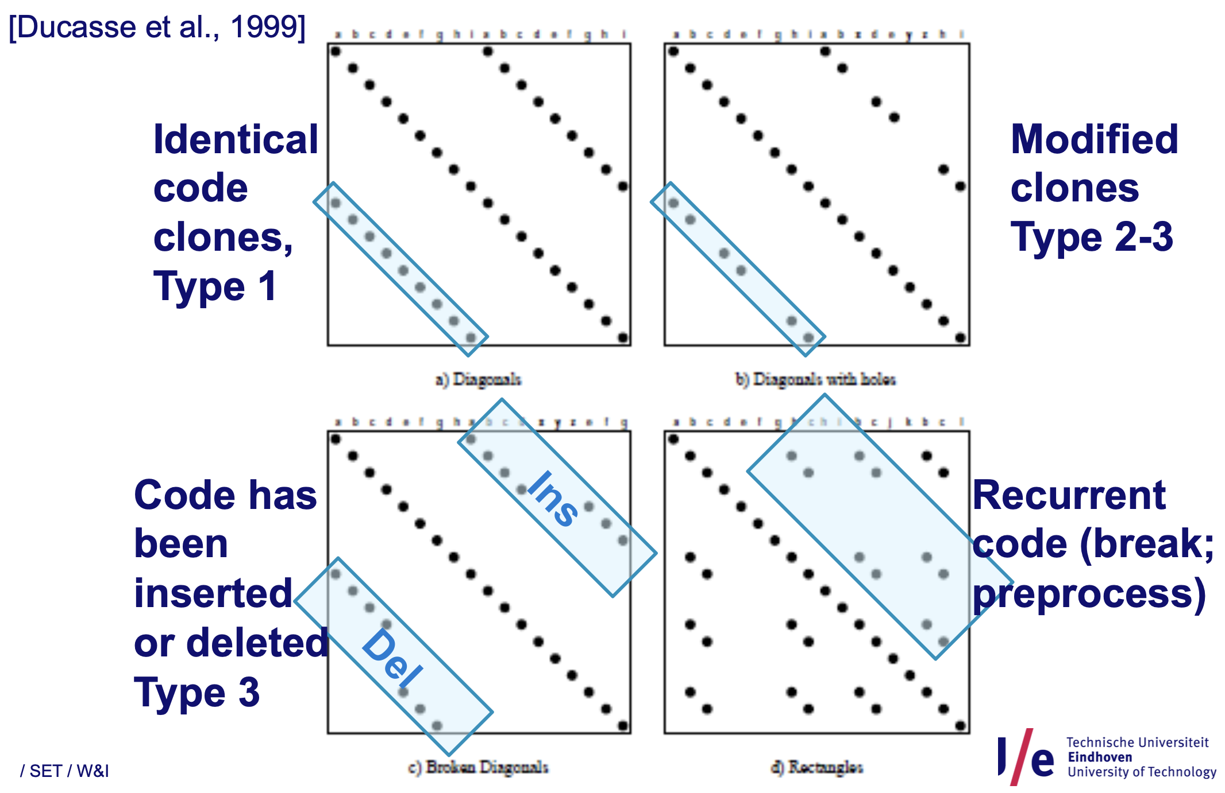

Slide 47
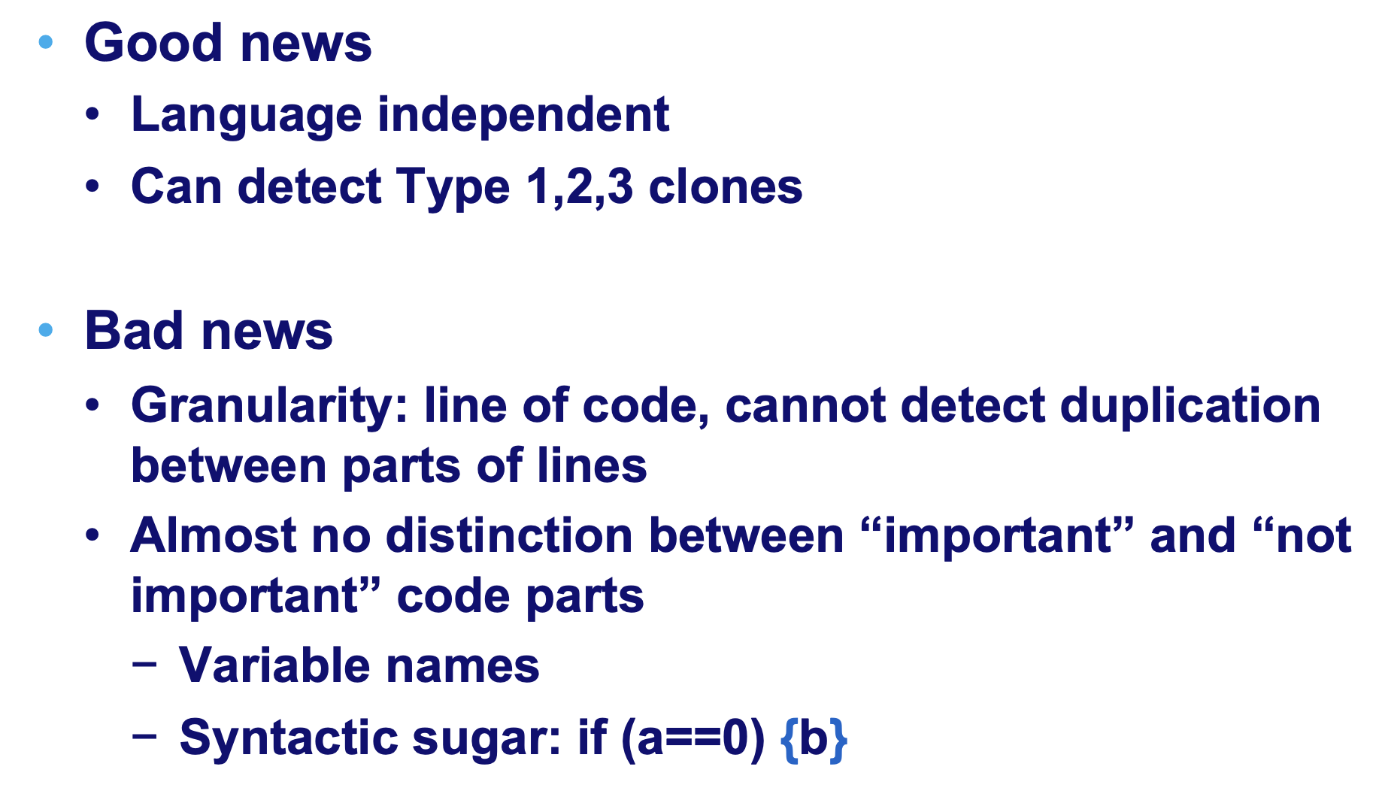
Text-based (cont’d)

Slide 48
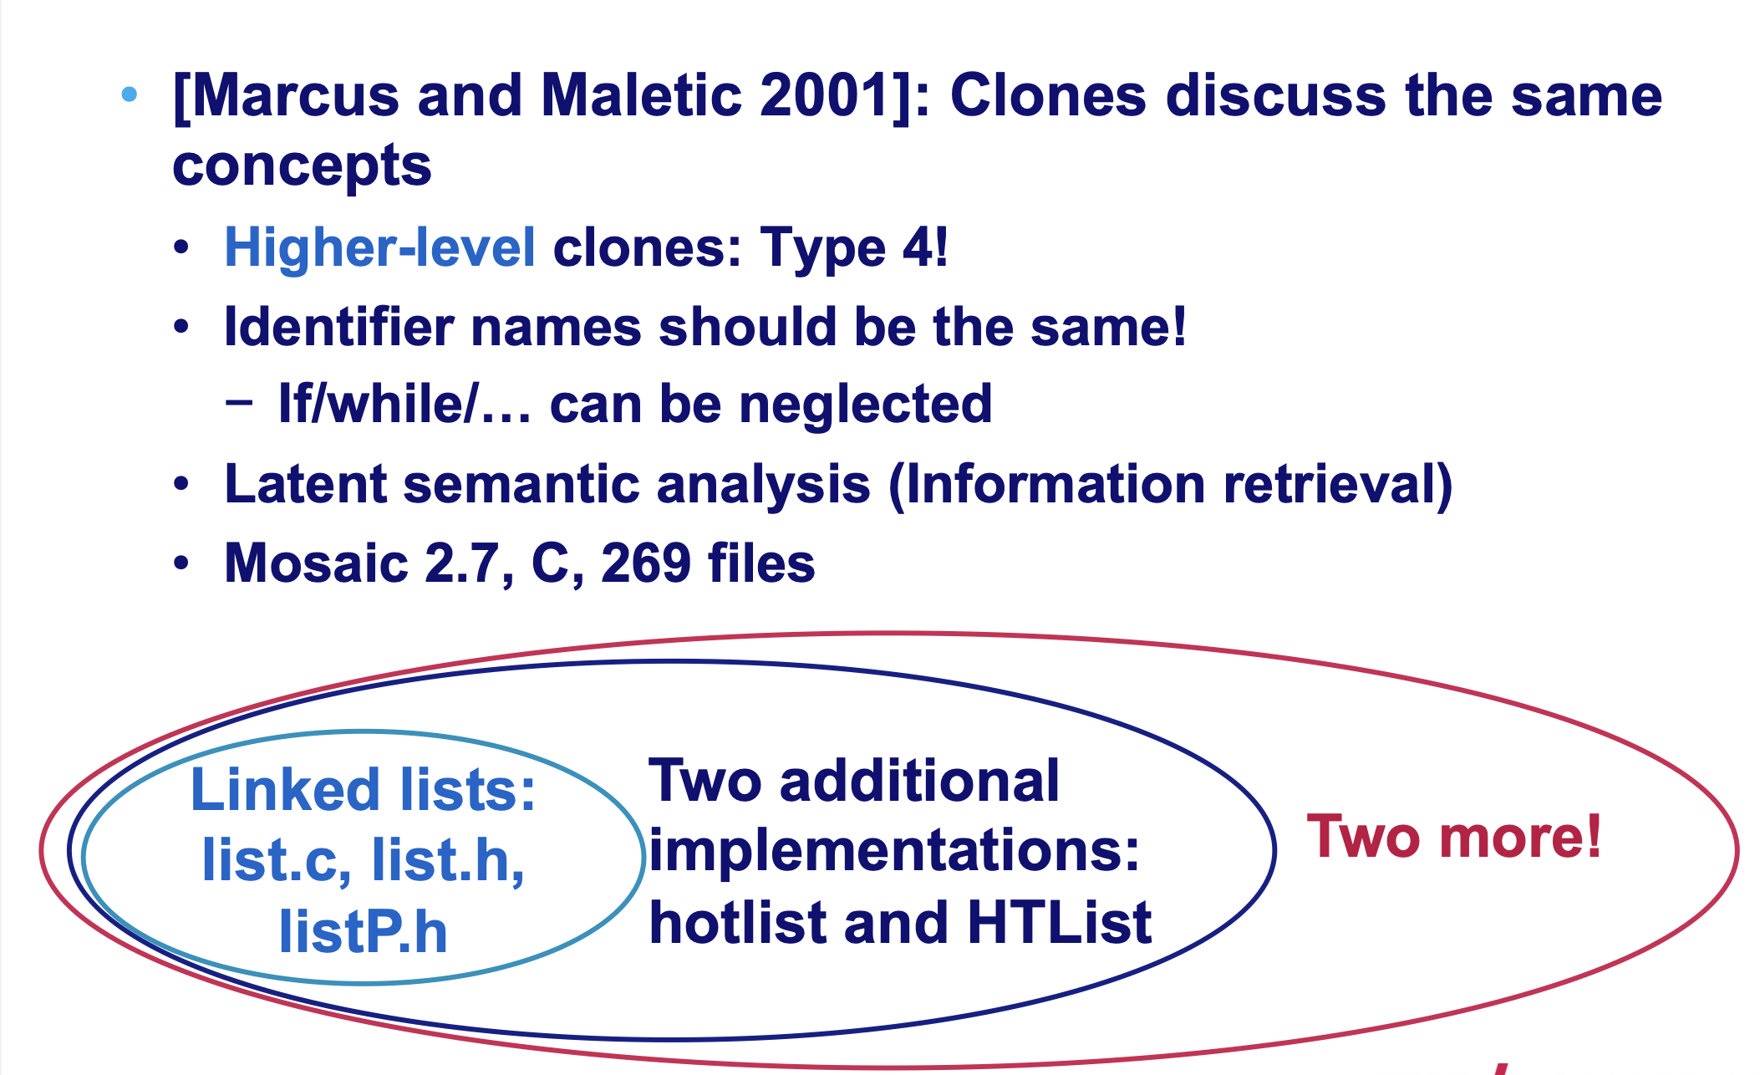
Alternative textual comparison approach

Slide 49
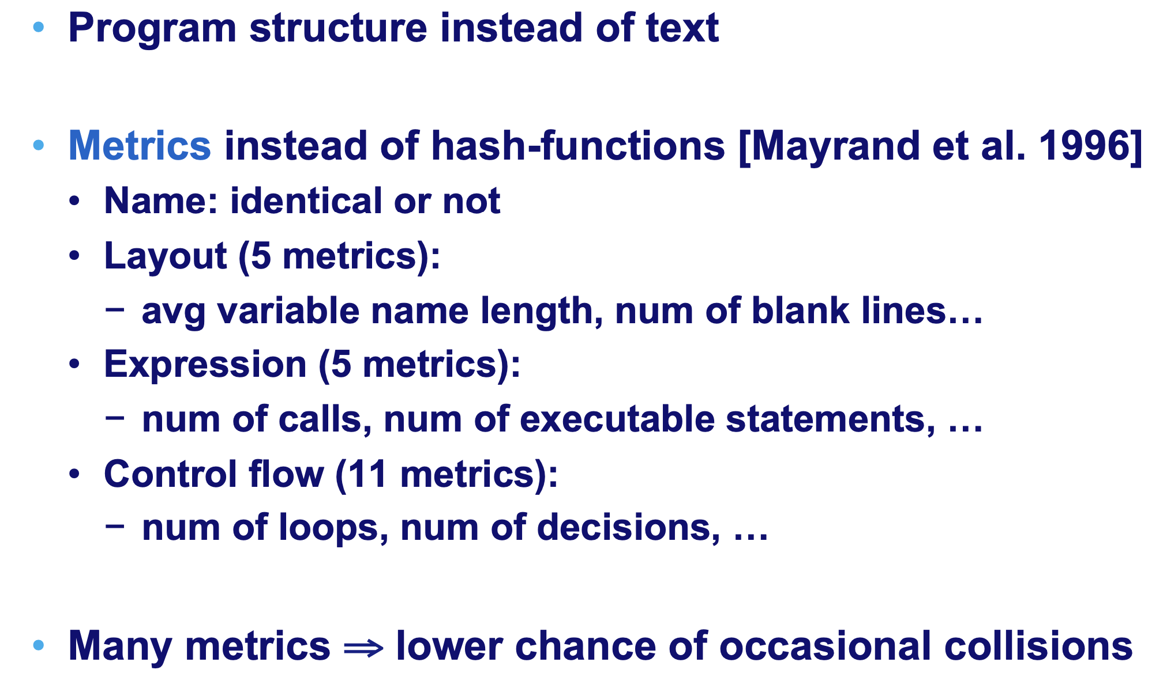
Extending the text-based approach

Slide 50
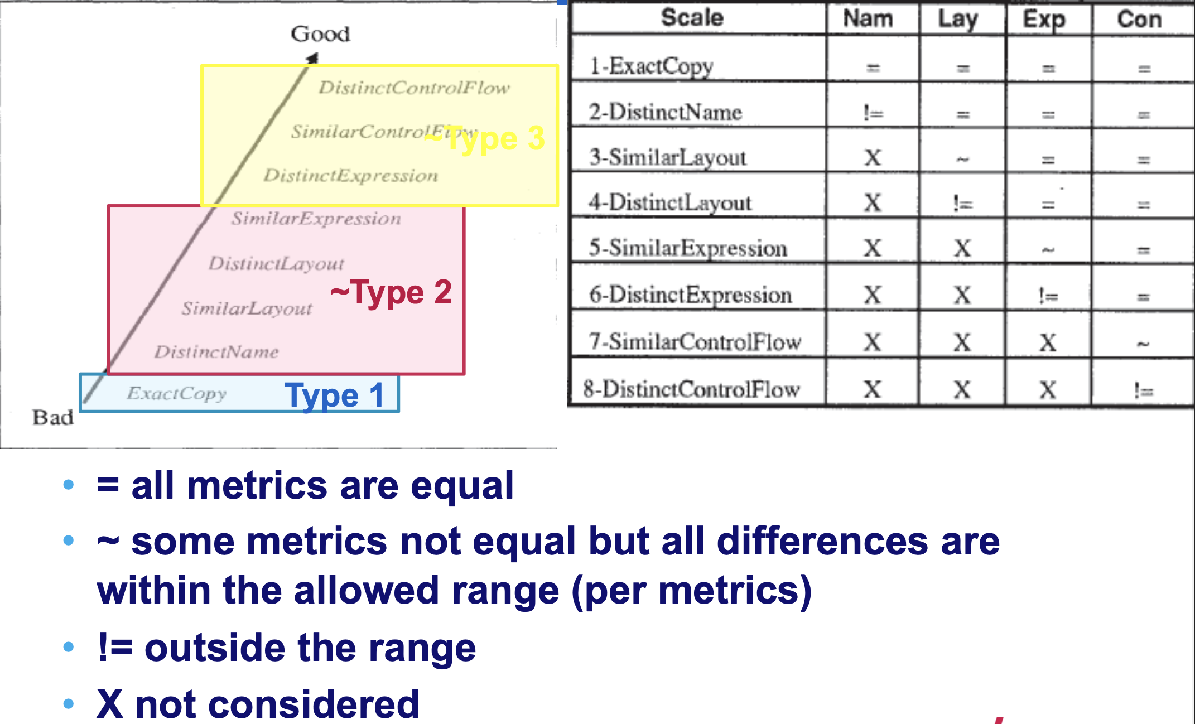
Metrics-based clone detection
~Type 3

Slide 51
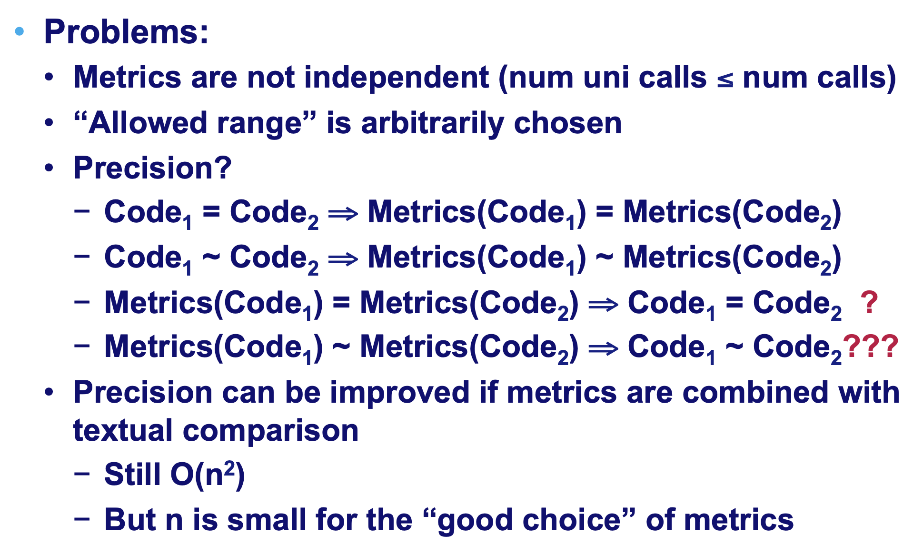
Metrics-based approaches: Discussion

Slide 52
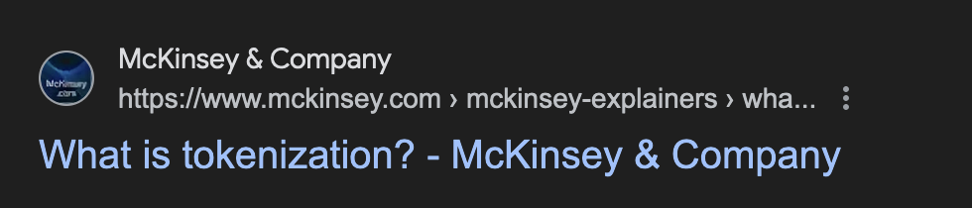
More fine-grained approaches: Tokenization!
“Tokenization is the process of creating a digital representation of a real thing […] A terracotta soldier figurine emerging from a digital tablet.”

Slide 53
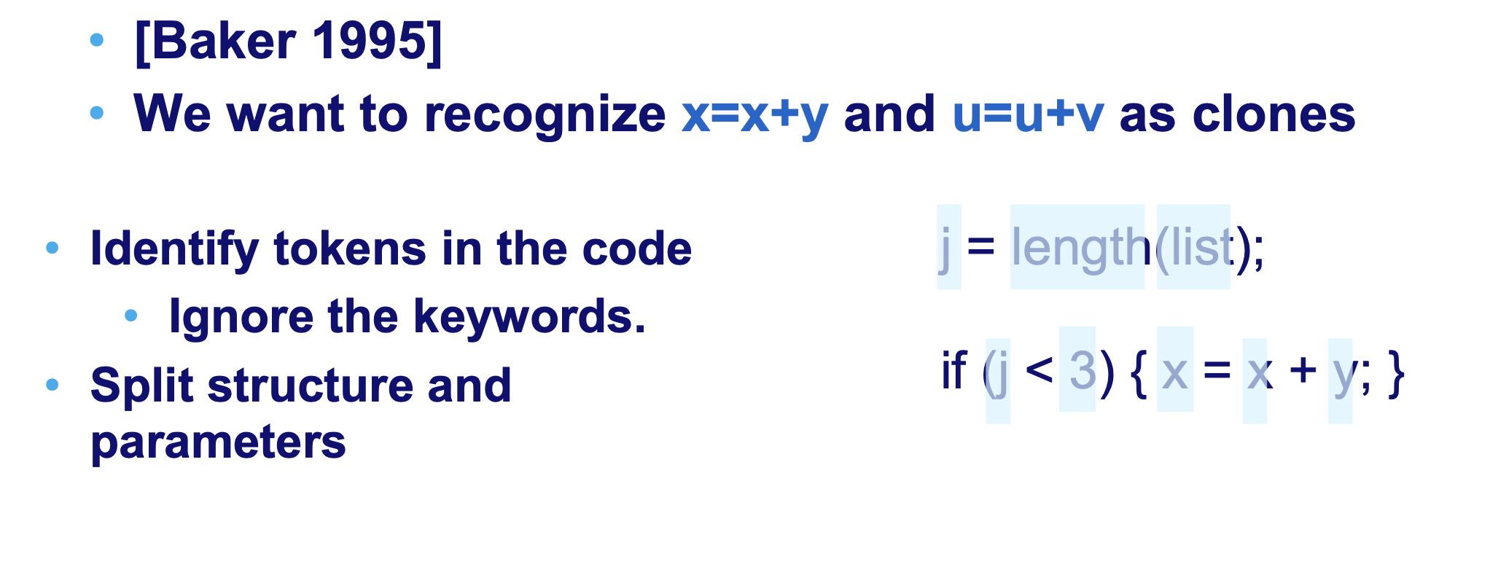
More fine-grained approaches: Tokenization!

Slide 54
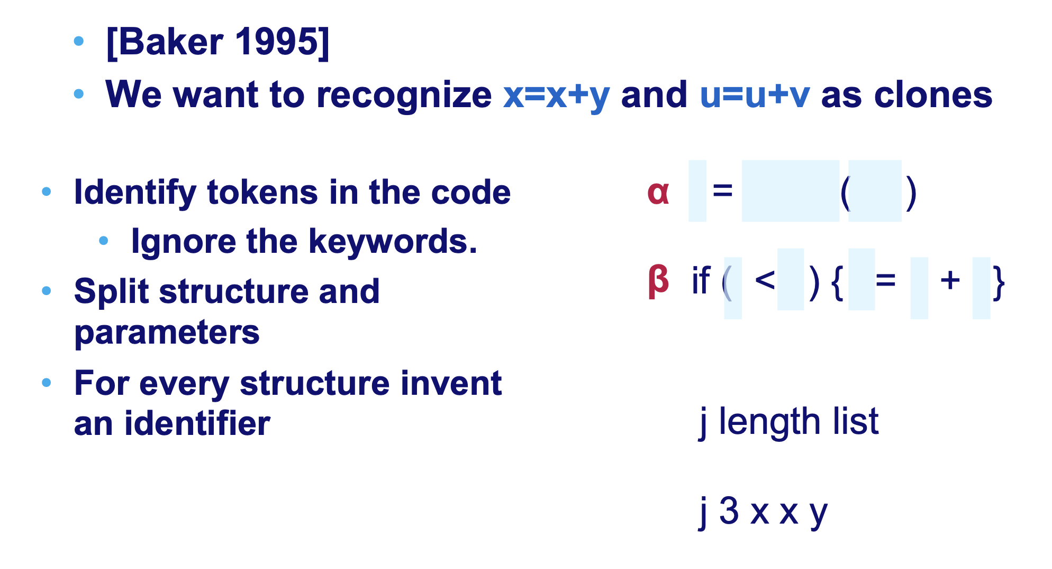
More fine-grained approaches: Tokenization!

Slide 55
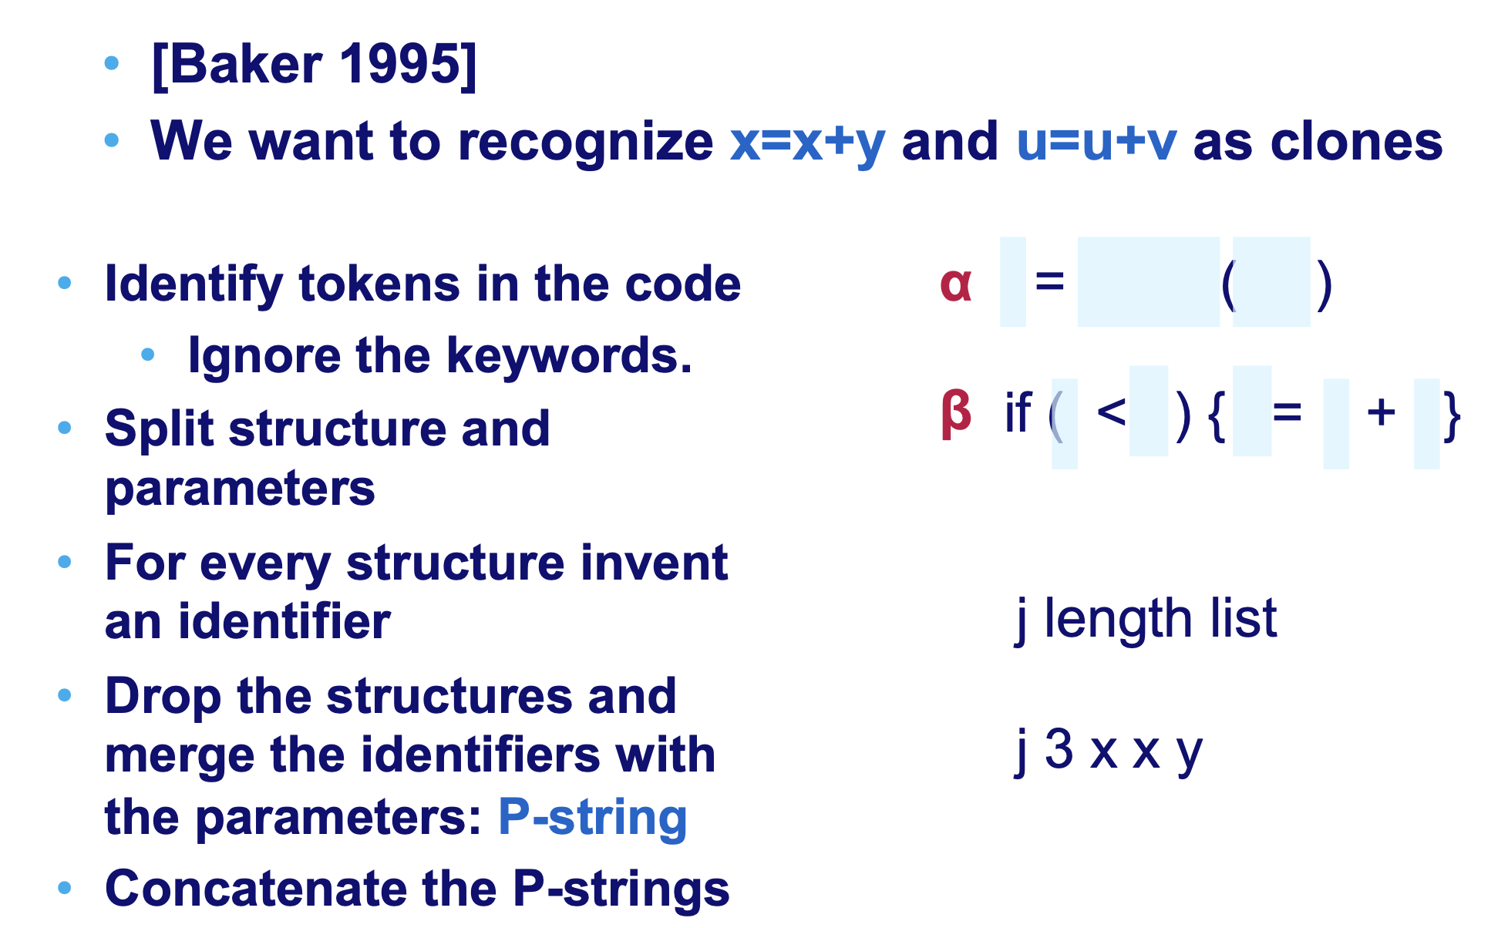
More fine-grained approaches: Tokenization!

Slide 56
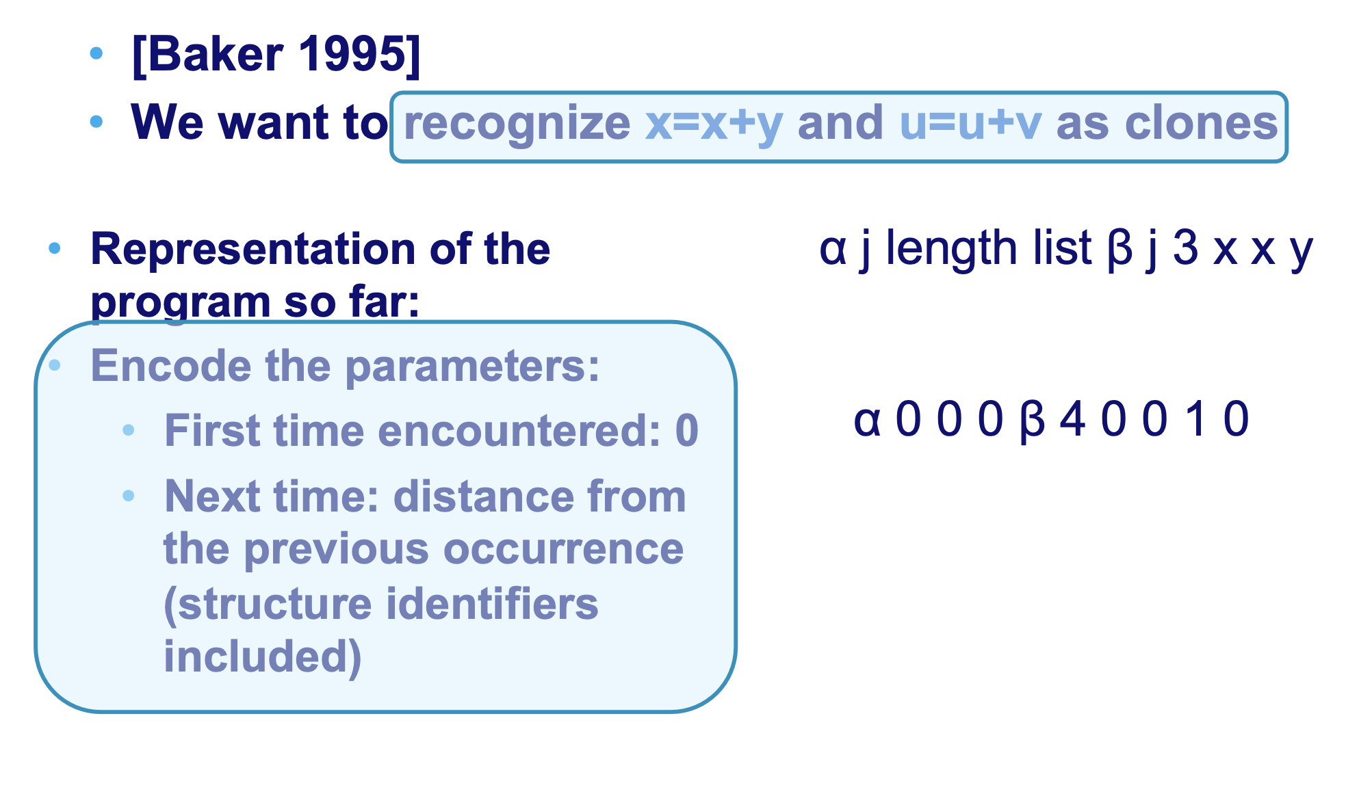
More fine-grained approaches: Tokenization!

Slide 57
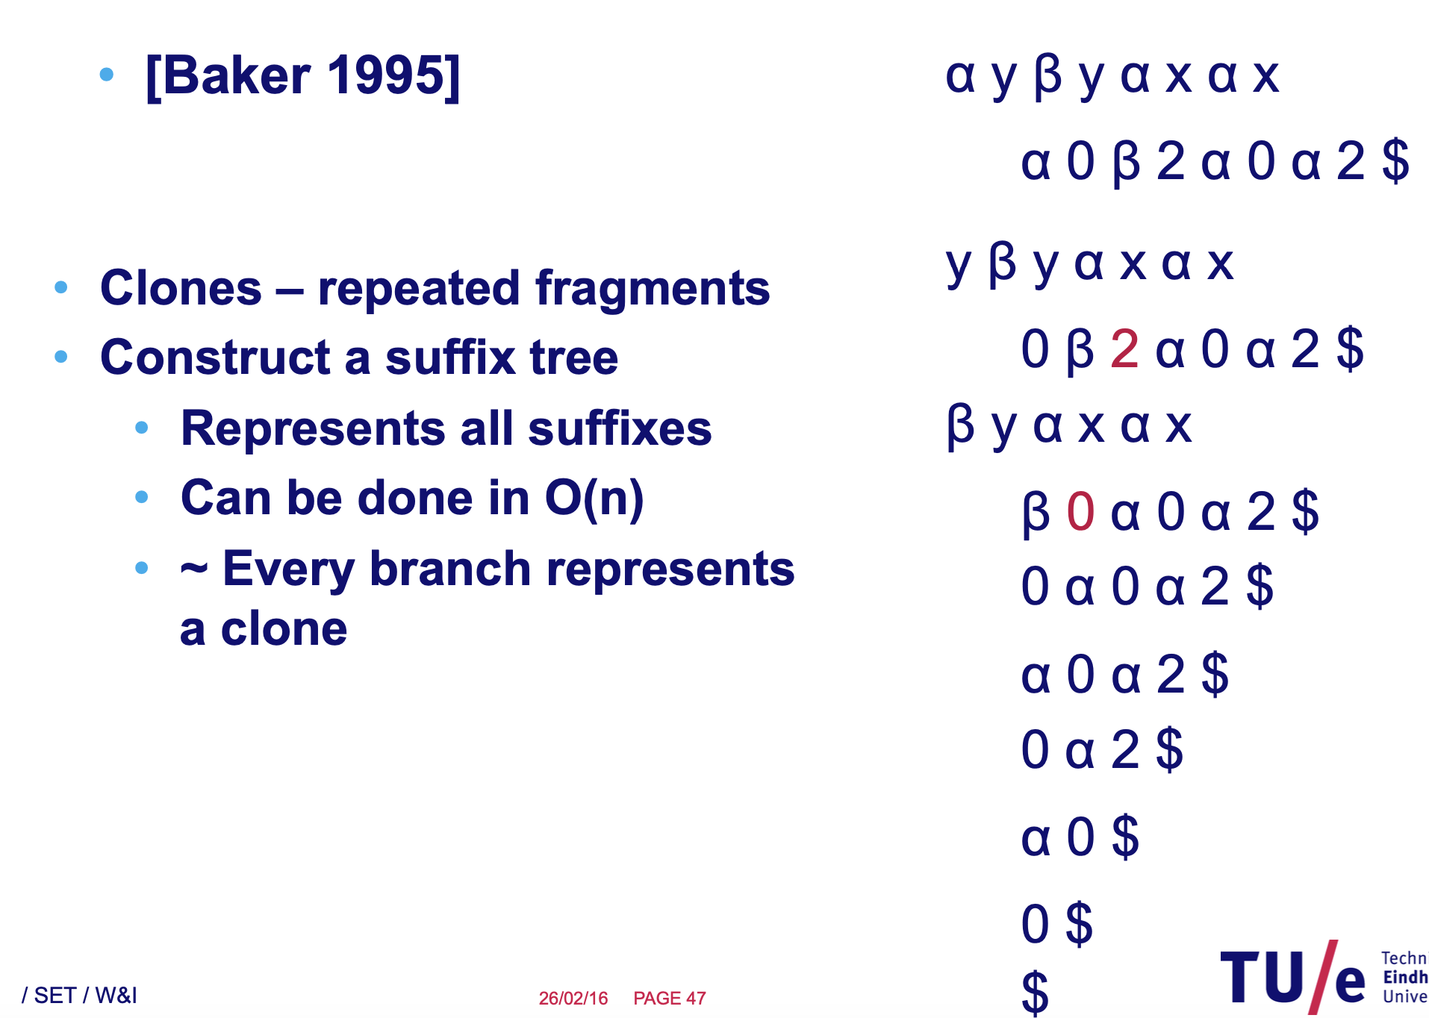
More fine-grained approaches: Tokenization!

Slide 58
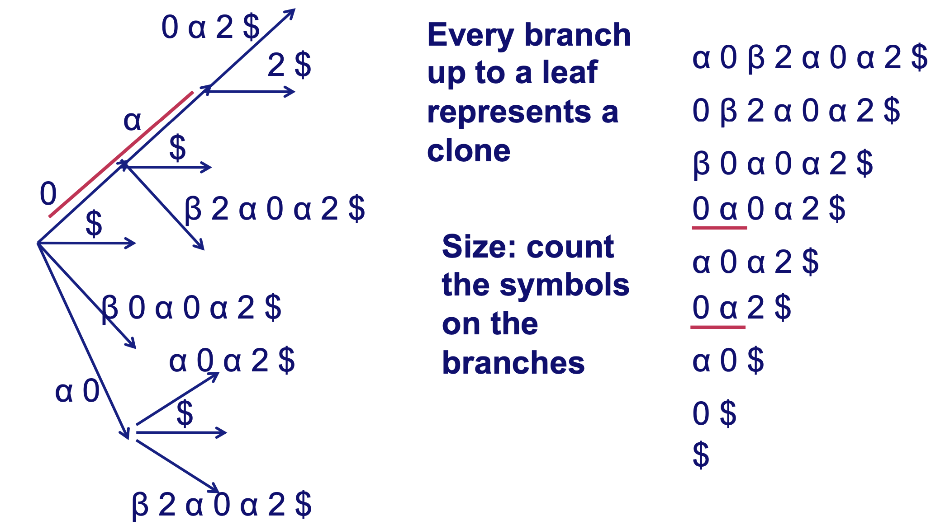
More fine-grained approaches: Tokenization!

Slide 59
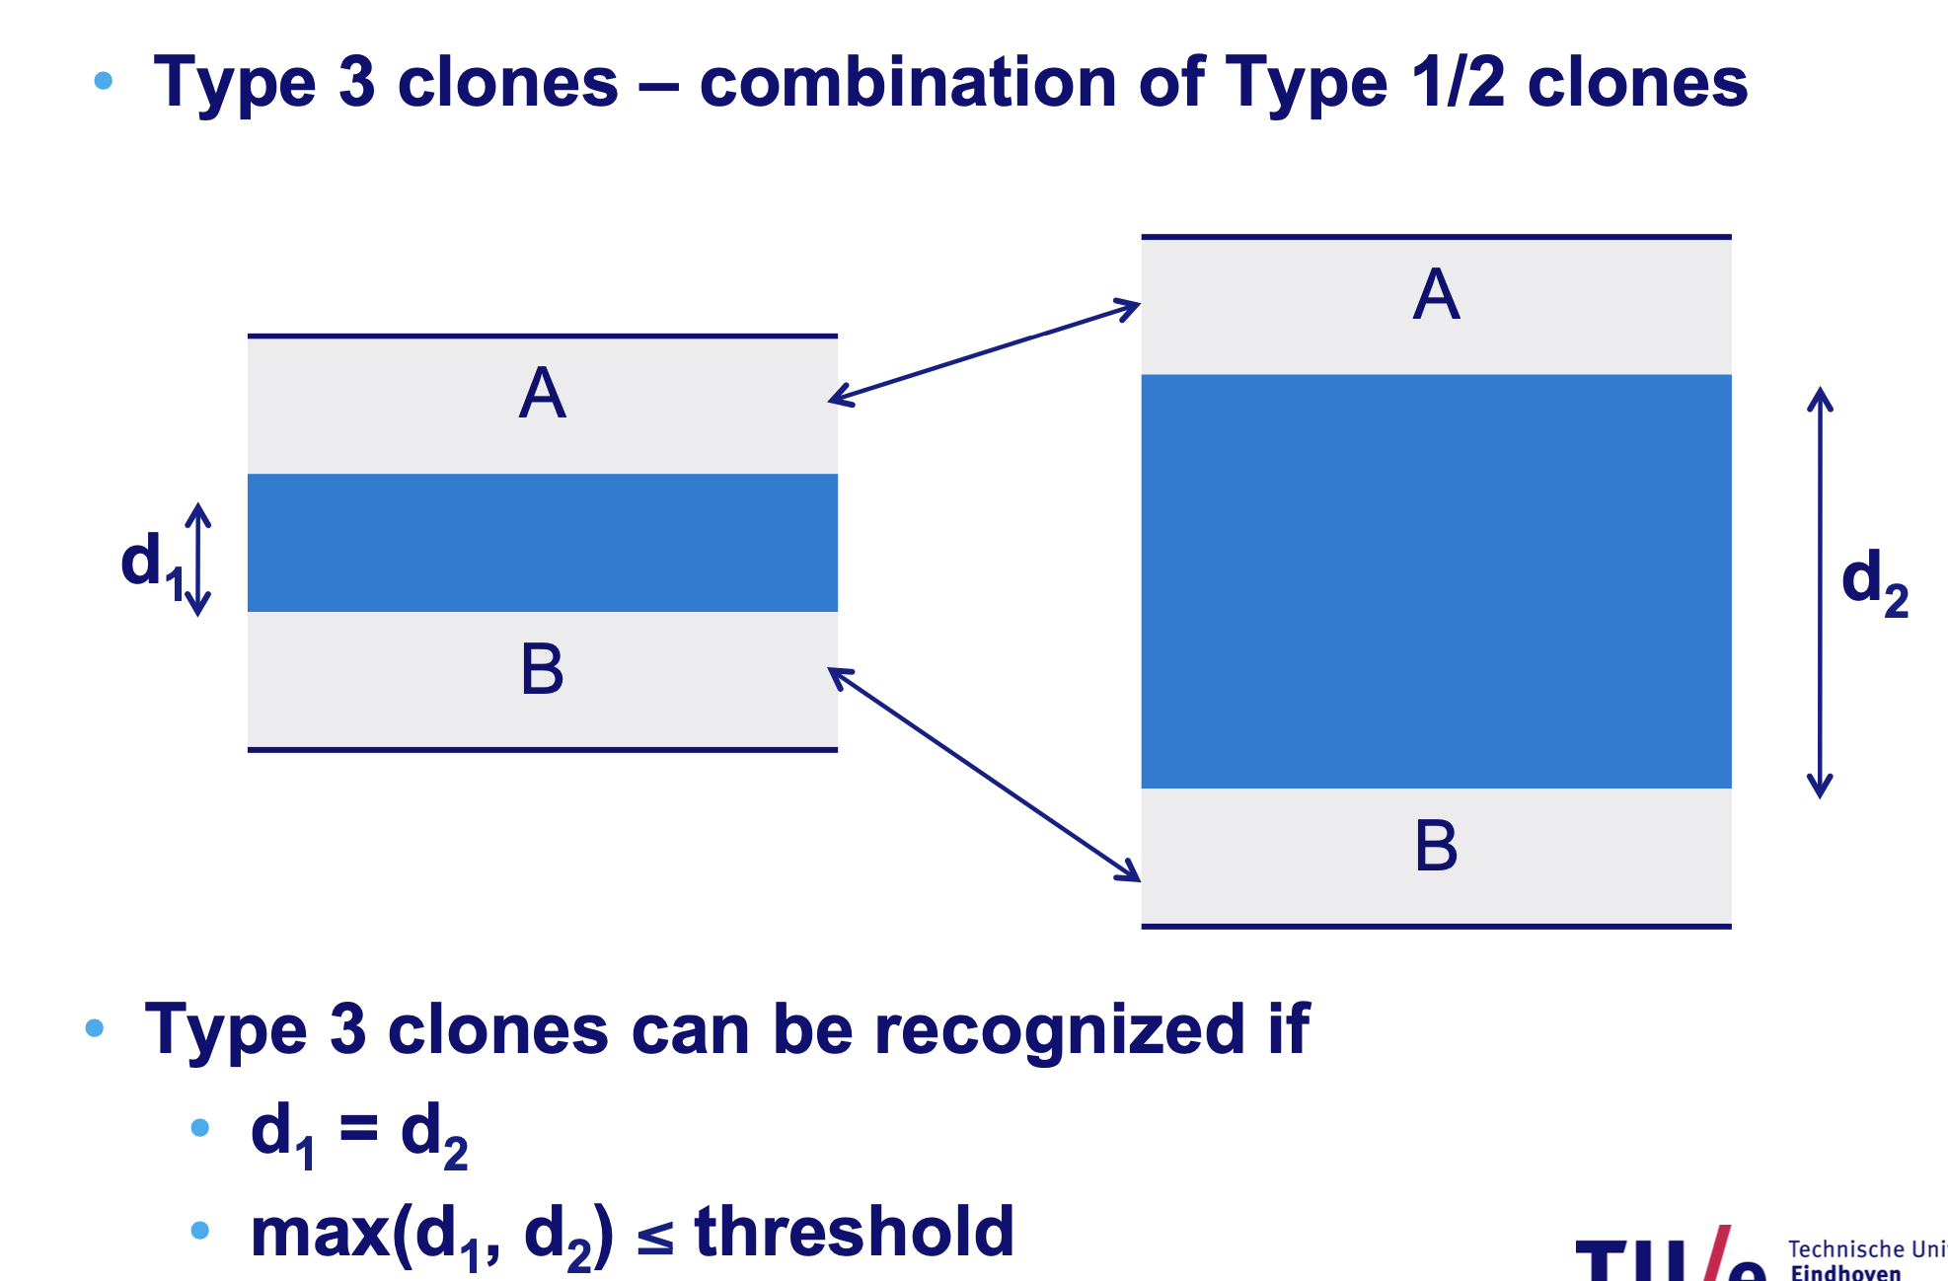
So far only Type 1 and Type 2 clones

Slide 60
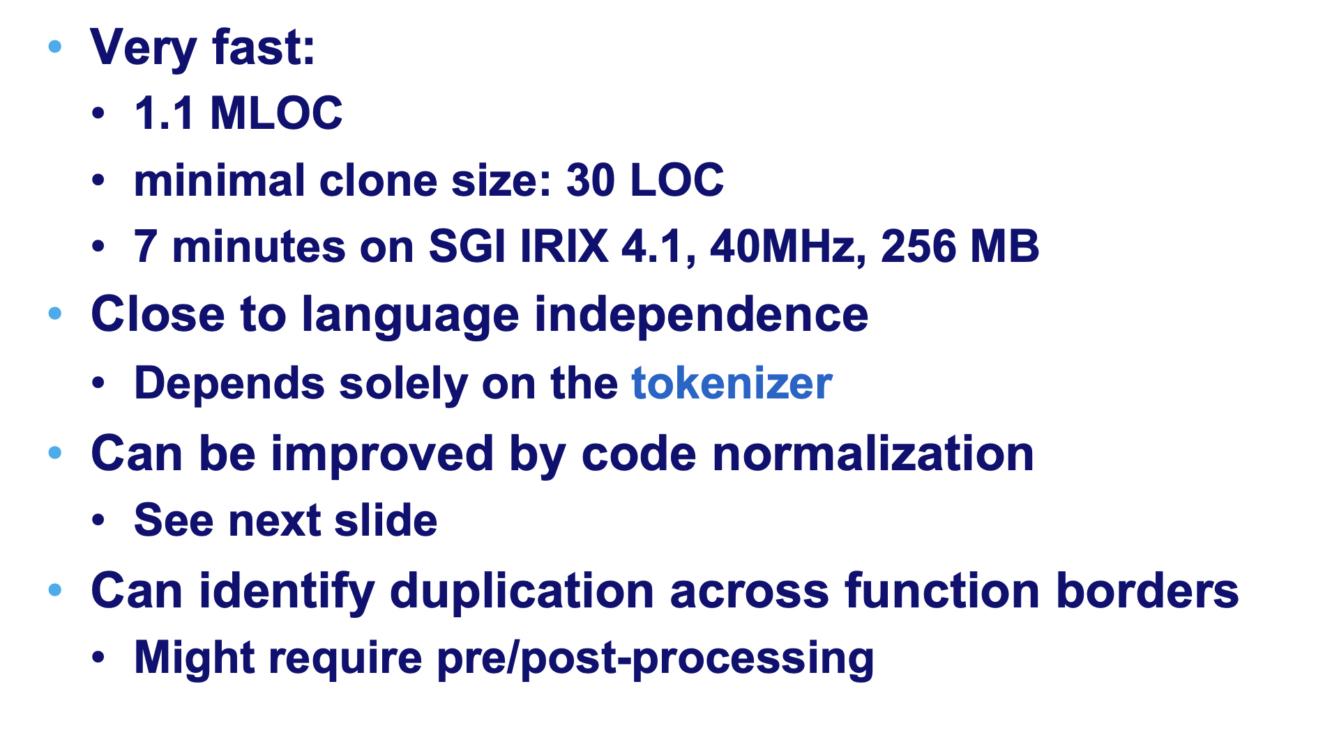
Baker’s approach: Discussion

Slide 61
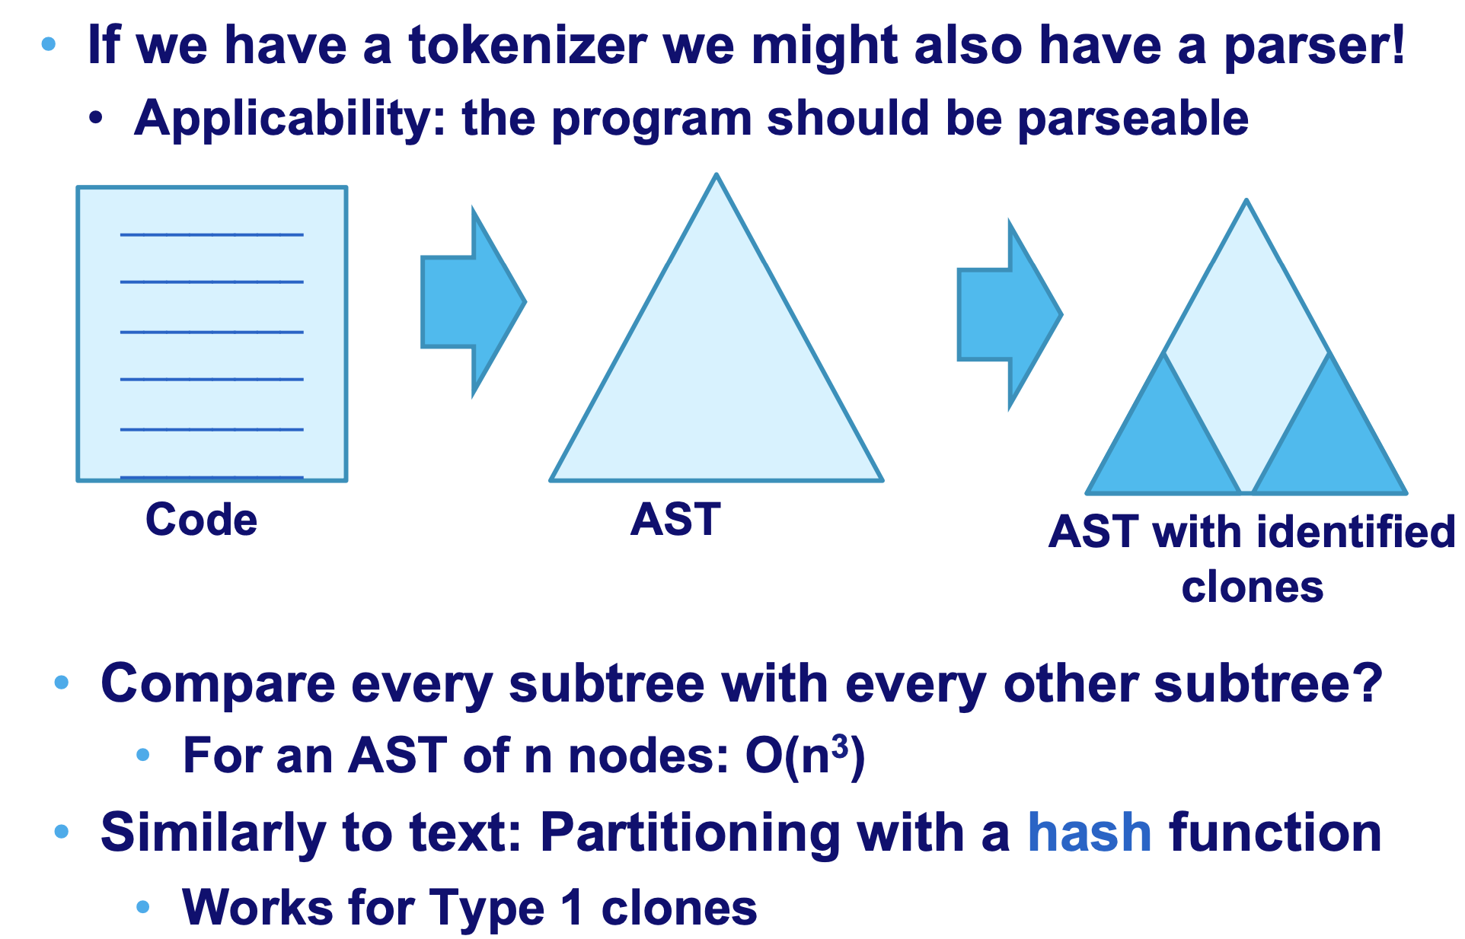
More advanced approaches: AST-based clone detection [Baxter 1996]

Slide 62
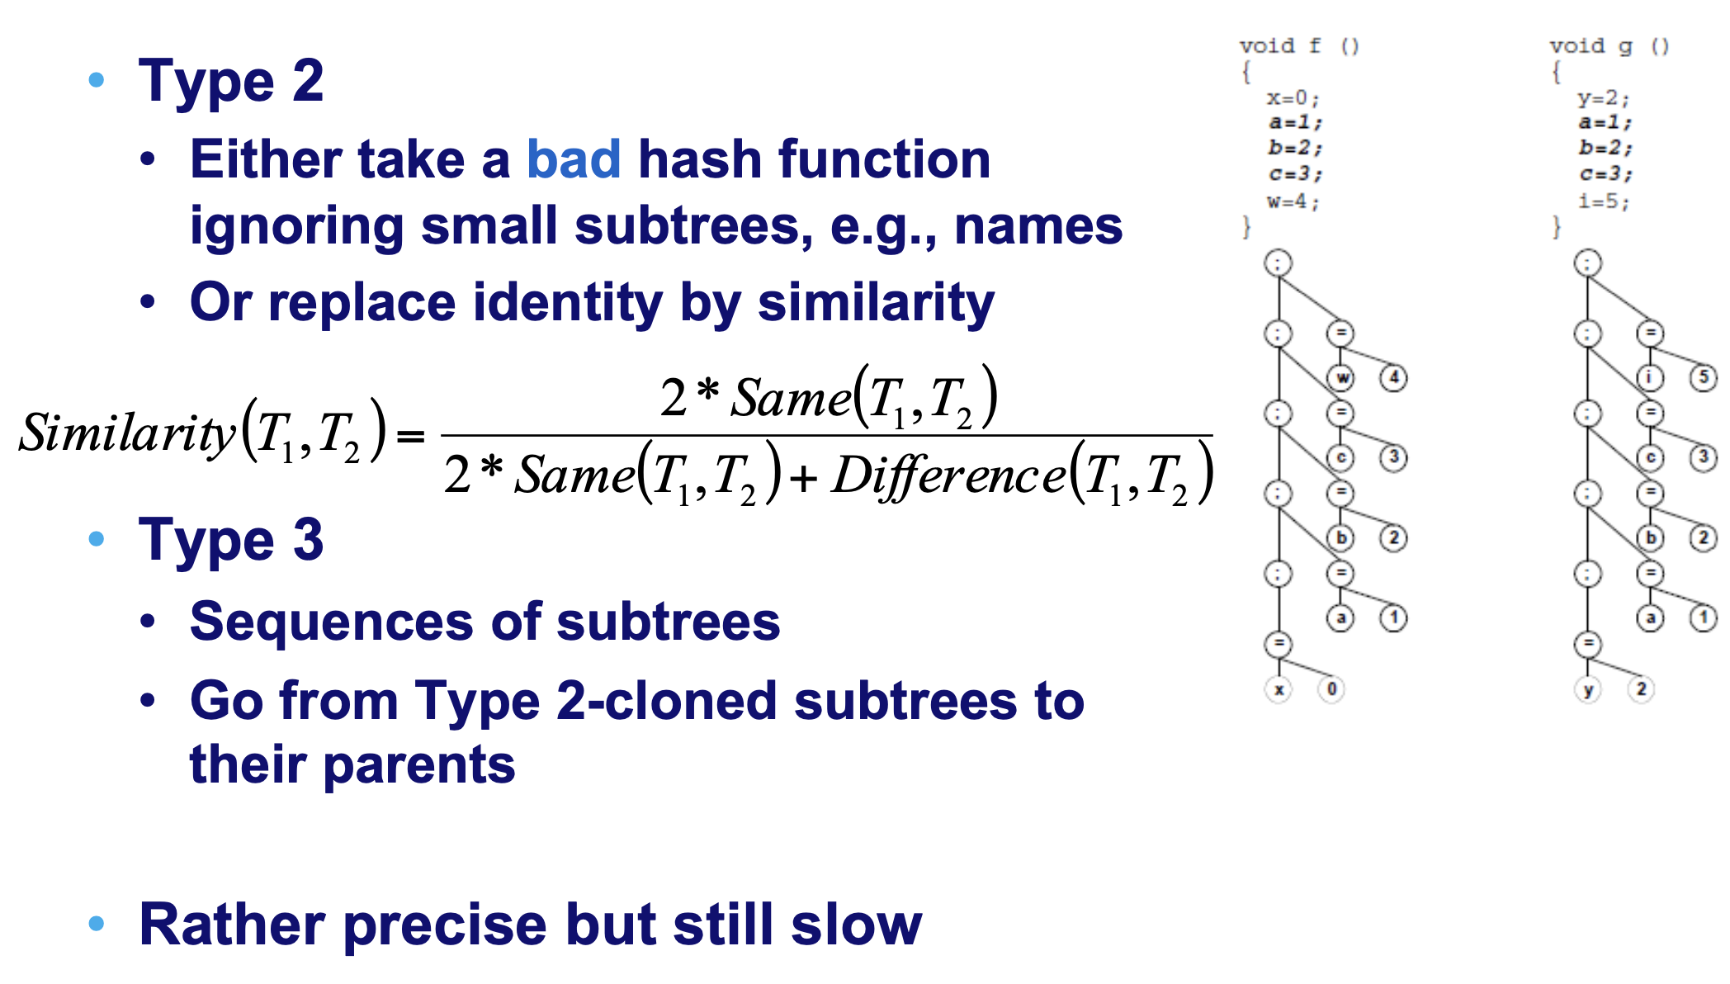
AST-based detection

Slide 63
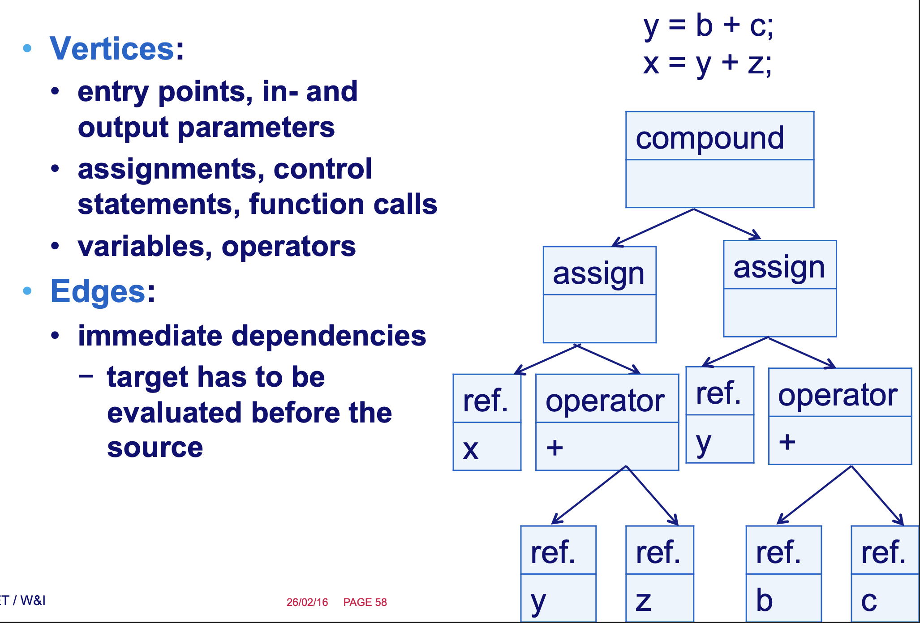
Improving AST-based Approaches: Program Dependence Graphs!

Slide 64

[Krinke 2001] PDG based detection

Slide 65

Identification of similar subgraphs – Theory

Slide 66

Identification of similar subgraphs – Practice

Slide 67

Choosing your tools: Precision / Recall

Slide 68

Which technique/tool is the best one?

Slide 69

Clones & evolution

Slide 70

The LLM Bit…
“despite LLMs potential for code generation, their capacity to consistently generate syntactically diverse but behaviorally equivalent code clones is *very* limited.”
“need for further quality assurance measures for the use of LLMs for code clones”

Slide 71


(con’d)
“However, they do not reach impressive accuracy [<70%].”

Slide 72

Clone detection techniques: Summary

Slide 73

Final word on clones: they eventually lead to Dead Code!

Slide 74

Questions?

Slide 75
References
Comic from: http://www.irregularwebcomic.net/cgi-bin/comic.pl?comic=687
http://www.refactoring.com/catalog/index.html
http://www.cs.colorado.edu/~kena/classes/6448/s05/lectures/lecture18.pdf
http://www.codeproject.com/KB/architecture/practicalexp.aspx
Most of articles are linked in our ref. text book!

